Slide 1

第五章 文件系统

Slide 2
主要内容
5.1
概述
5.2
文件组织和访问
5.3
文件目录
5.4
文件共享
5.5
记录组块
5.6
辅存管理
5.7
UNIX文件管理
5.8
Windows文件系统
5.9
Linux虚拟文件系统

Slide 3
5.1 概述
文件：用户或系统创建的数据集
从用户的角度来看，文件是操作系统的重要组成部分
文件拥有的理想属性:
长期存在
文件存储在硬盘或其它辅存中，用户退出系统时文件不会消失
可在进程间共享
文件有名字，具有允许受控共享的相关访问权限
结构
文件可以组织成为层次结构或更复杂的结构，以反映文件之间的关系
Notes:
From the user’s point of view, one of the most important parts of an operating
system is the file system. The file system provides the resource abstractions typically
associated with secondary storage. The file system permits users to create data
collections, called files, with desirable properties, such as:
• Long-term existence: Files are stored on disk or other secondary storage and
do not disappear when a user logs off.
• Sharable between processes: Files have names and can have associated access
permissions that permit controlled sharing.
• Structure: Depending on the file system, a file can have an internal structure
that is convenient for particular applications. In addition, files can be organized
into hierarchical or more complex structure to reflect the relationships
among files.

Slide 4
5.1 概述
文件系统
提供存储数据的手段，且提供一系列对文件进行操作的功能接口
为文件维护一组属性
典型文件操作:
创建
删除
打开
关闭
读
写
Notes:
Any file system provides not only a means to store data organized as files, but
a collection of functions that can be performed on files. Typical operations include
the following:
• Create: A new file is defined and positioned within the structure of files.
• Delete: A file is removed from the file structure and destroyed.
• Open: An existing file is declared to be “opened” by a process, allowing the
process to perform functions on the file.
• Close: The file is closed with respect to a process, so that the process no longer
may perform functions on the file, until the process opens the file again.
• Read: A process reads all or a portion of the data in a file.
• Write: A process updates a file, either by adding new data that expands the
size of the file or by changing the values of existing data items in the file.
Typically, a file system maintains a set of attributes associated with the file.
These include owner, creation time, time last modified, access privileges, and so on.

Slide 5
5.1 概述
文件结构
四个术语:
域
记录
文件
数据库
Notes:
Four terms are in common use when discussing files:
• Field
• Record
• File
• Database

Slide 6
5.1 概述
文件结构术语
域
记录
基本数据单元
包含一个值
定长或变长
一组相关域的集合，可视为应用程序的一个单元
定长或变长
文件
数据库
一组相似记录的集合
可被用户和应用程序视为一个实体
通过名字访问
访问控制通常在文件级实施
相关的数据集合
数据元素之间存在明确的关系
供不同的应用程序使用
由一种或多种类型的文件组成
Notes:
A field is the basic element of data. An individual field contains a single value,
such as an employee’s last name, a date, or the value of a sensor reading. It is characterized
by its length and data type (e.g., ASCII string, decimal). Depending on the
file design, fields may be fixed length or variable length. In the latter case, the field
often consists of two or three subfields: the actual value to be stored, the name of
the field, and, in some cases, the length of the field. In other cases of variable-length
fields, the length of the field is indicated by the use of special demarcation symbols
between fields.
A record is a collection of related fields that can be treated as a unit by some
application program. For example, an employee record would contain such fields
as name, social security number, job classification, date of hire, and so on. Again,
depending on design, records may be of fixed length or variable length. A record
will be of variable length if some of its fields are of variable length or if the number
of fields may vary. In the latter case, each field is usually accompanied by a field
name. In either case, the entire record usually includes a length field.
A file is a collection of similar records. The file is treated as a single entity by
users and applications and may be referenced by name. Files have file names and
may be created and deleted. Access control restrictions usually apply at the file
level. That is, in a shared system, users and programs are granted or denied access
to entire files. In some more sophisticated systems, such controls are enforced at the
record or even the field level.
Some file systems are structured only in terms of fields, not records. In that
case, a file is a collection of fields.
A database is a collection of related data. The essential aspects of a database
are that the relationships that exist among elements of data are explicit and that the
database is designed for use by a number of different applications. A database may
contain all of the information related to an organization or project, such as a business
or a scientific study. The database itself consists of one or more types of files. Usually,
there is a separate database management system that is independent of the operating
system, although that system may make use of some file management programs.

Slide 7
5.1 概述
文件管理的目标
满足数据管理要求和用户需求
保证文件中的数据有效
优化性能
为各种类型的存储设备提供I/O支持
最大限度地减少丢失或破坏数据的可能性
为用户进程提供标准I/O接口例程集
在多用户系统中为多个用户提供I/O支持
Notes:
A file management system is that set of system software that provides services to
users and applications in the use of files. Typically, the only way that a user or application
may access files is through the file management system. This relieves the user
or programmer of the necessity of developing special-purpose software for each
application and provides the system with a consistent, well-defined means of controlling
its most important asset. [GROS86] suggests the following objectives for a
file management system:
• To meet the data management needs and requirements of the user, which include
storage of data and the ability to perform the aforementioned operations
• To guarantee, to the extent possible, that the data in the file are valid
• To optimize performance, both from the system point of view in terms of
overall throughput and from the user’s point of view in terms of response time
• To provide I/O support for a variety of storage device types
• To minimize or eliminate the potential for lost or destroyed data
• To provide a standardized set of I/O interface routines to user processes
• To provide I/O support for multiple users, in the case of multiple-user systems

Slide 8
5.1 概述
用户的最小需求范围
用户能够
1
能够创建、删除、读取和修改文件
2
能够受控地访问其他用户的文件
3
控制允许进行哪些类型的访问
4
5
6
7
能够以适合问题的形式重组文件
能够在文件间移动数据
能够备份文件，且在文件遭到破坏时恢复文件
能够通过名字而非数字标识符访问自己的文件
Notes:
With respect to the first point, meeting user requirements, the extent of such
requirements depends on the variety of applications and the environment in which
the computer system will be used. For an interactive, general-purpose system, the
following constitute a minimal set of requirements:
1. Each user should be able to create, delete, read, write, and modify files.
2. Each user may have controlled access to other users’ files.
3. Each user may control what types of accesses are allowed to the user’s files.
4. Each user should be able to restructure the user’s files in a form appropriate to
the problem.
5. Each user should be able to move data between files.
6. Each user should be able to back up and recover the user’s files in case of
damage.
7. Each user should be able to access his or her files by name rather than by
numeric identifier.
These objectives and requirements should be kept in mind throughout our discussion
of file management systems.

Slide 9
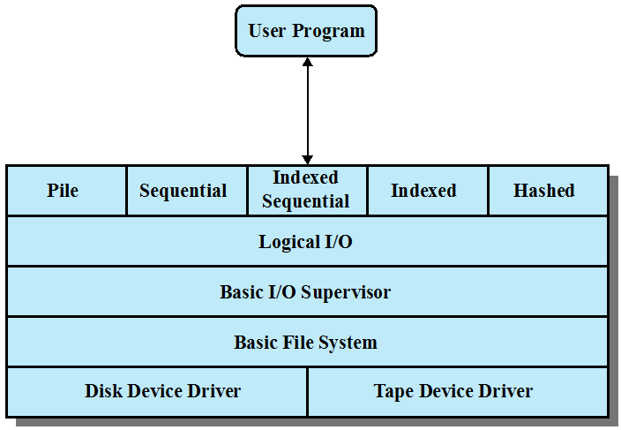
5.1 概述
文件系统架构
用户程序
堆
顺序
索引顺序
索引
散列
逻辑I/O
基本I/O管理程序
基本文件系统
磁盘设备驱动
磁带设备驱动
Notes:
With respect to the first point, meeting user requirements, the extent of such
requirements depends on the variety of applications and the environment in which
the computer system will be used. For an interactive, general-purpose system, the
following constitute a minimal set of requirements:
1. Each user should be able to create, delete, read, write, and modify files.
2. Each user may have controlled access to other users’ files.
3. Each user may control what types of accesses are allowed to the user’s files.
4. Each user should be able to restructure the user’s files in a form appropriate to
the problem.
5. Each user should be able to move data between files.
6. Each user should be able to back up and recover the user’s files in case of
damage.
7. Each user should be able to access his or her files by name rather than by
numeric identifier.
These objectives and requirements should be kept in mind throughout our discussion
of file management systems.

Slide 10
5.1 概述
设备驱动
最底层
直接与外围设备（或它们的控制器或通道）通信
负责启动设备上的I/O操作
处理I/O请求的完成
通常视为操作系统的一个组成部分
Notes:
The next level is referred to as the basic file system , or the physical I/O level.
This is the primary interface with the environment outside of the computer system.
It deals with blocks of data that are exchanged with disk or tape systems. Thus, it is
concerned with the placement of those blocks on the secondary storage device and
on the buffering of those blocks in main memory. It does not understand the content
of the data or the structure of the files involved. The basic file system is often
considered part of the operating system.

Slide 11
5.1 概述
基本文件系统
称为物理I/O层
与计算机外部环境的基本接口
处理在磁盘间或磁带系统间的数据块
关注数据块在辅存的放置位置
关注数据块在内存缓冲区的放置位置
通常视为操作系统的一个组成部分
Notes:
The next level is referred to as the basic file system , or the physical I/O level.
This is the primary interface with the environment outside of the computer system.
It deals with blocks of data that are exchanged with disk or tape systems. Thus, it is
concerned with the placement of those blocks on the secondary storage device and
on the buffering of those blocks in main memory. It does not understand the content
of the data or the structure of the files involved. The basic file system is often
considered part of the operating system.

Slide 12

5.1 概述
基本I/O管理程序
负责所有文件I/O的初始化和终止
维护处理设备I/O，调度和文件状态的控制结构
选择要执行I/O的设备
关注调度磁盘和磁带访问以优化性能
I/O缓冲区的指定和辅存的分配
通常视为操作系统的一个组成部分
Notes:
The basic I/O supervisor is responsible for all file I/O initiation and termination.
At this level, control structures are maintained that deal with device I/O,
scheduling, and file status. The basic I/O supervisor selects the device on which file
I/O is to be performed, based on the particular file selected. It is also concerned
with scheduling disk and tape accesses to optimize performance. I/O buffers are
assigned and secondary memory is allocated at this level. The basic I/O supervisor is
part of the operating system.

Slide 13
5.1 概述
逻辑I/O
使用户和应用程序能够访问记录
提供一种通用的记录I/O能力
维护文件基本数据
Notes:
Logical I/O enables users and applications to access records. Thus, whereas
the basic file system deals with blocks of data, the logical I/O module deals with file
records. Logical I/O provides a general-purpose record I/O capability and maintains
basic data about files.

Slide 14
5.1 概述
访问方法
文件系统中与用户最近的一层
提供应用程序和文件系统以及保存数据的设备之间的标准接口
不同的访问方法反映了不同的文件结构以及访问和处理数据的不同方式
Notes:
The level of the file system closest to the user is often termed the access
method . It provides a standard interface between applications and the file systems
and devices that hold the data. Different access methods reflect different file structures
and different ways of accessing and processing the data. Some of the most
common access methods are shown in Figure 12.1 , and these are briefly described
in Section 12.2 .

Slide 15
5.1 概述
文件管理的要素
用户和应用程序通过文件操作与文件系统交互，通过目录确定文件的位置。
授权用户以特定的方式访问特定的文件；
用户通过文件操作函数，基于字符流／或记录来操作文件；
系统对文件的I/O是以块为单位，基于块来完成输入／输出；
操作系统需要为文件在磁盘上分配空闲块，同时还需要管理空闲空间。
内存缓冲区中的物理块
辅存(磁盘)中的物理块
文件组织
字符流/记录
目录管理
访问方法
组块
磁盘调度
用户程序和命令
操作，
文件名
文件操作函数
I/O
空闲空间管理
文件分配
用户访问控制
文件系统关注的问题
操作系统关注的问题
Notes:
Another way of viewing the functions of a file
system is shown in Figure 12.2 . Let us follow this diagram from left to right. Users
and application programs interact with the file system by means of commands for
creating and deleting files and for performing operations on files. Before performing
any operation, the file system must identify and locate the selected file. This requires
the use of some sort of directory that serves to describe the location of all files, plus
their attributes. In addition, most shared systems enforce user access control: Only
authorized users are allowed to access particular files in particular ways. The basic
operations that a user or application may perform on a file are performed at the
record level. The user or application views the file as having some structure that
organizes the records, such as a sequential structure (e.g., personnel records are
stored alphabetically by last name). Thus, to translate user commands into specific
file manipulation commands, the access method appropriate to this file structure
must be employed.
Whereas users and applications are concerned with records or fields, I/O is
done on a block basis. Thus, the records or fields of a file must be organized as a
sequence of blocks for output and unblocked after input. To support block I/O of
files, several functions are needed. The secondary storage must be managed. This
involves allocating files to free blocks on secondary storage and managing free storage
so as to know what blocks are available for new files and growth in existing files.
In addition, individual block I/O requests must be scheduled; this issue was dealt with
in Chapter 11 . Both disk scheduling and file allocation are concerned with optimizing
performance. As might be expected, these functions therefore need to be considered
together. Furthermore, the optimization will depend on the structure of the files and
the access patterns. Accordingly, developing an optimum file management system
from the point of view of performance is an exceedingly complicated task.
Figure 12.2 suggests a division between what might be considered the concerns
of the file management system as a separate system utility and the concerns
of the operating system, with the point of intersection being record processing. This
division is arbitrary; various approaches are taken in various systems.
In the remainder of this chapter, we look at some of the design issues suggested
in Figure 12.2 . We begin with a discussion of file organizations and access
methods. Although this topic is beyond the scope of what is usually considered the
concerns of the operating system, it is impossible to assess the other file-related
design issues without an appreciation of file organization and access. Next, we look
at the concept of file directories. These are often managed by the operating system
on behalf of the file management system. The remaining topics deal with the physical
I/O aspects of file management and are properly treated as aspects of OS design.
One such issue is the way in which logical records are organized into physical blocks.
Finally, there are the related issues of file allocation on secondary storage and the
management of free secondary storage.

Slide 16
5.2 文件组织和访问
文件组织 （file organization）
指文件中记录的逻辑结构，由用户访问记录的方式确定
选择文件组织的5个重要原则:
快速访问
易于修改
节约存储空间
维护简单
可靠性
原则的优先级取决于使用文件的应用程序
Notes:
In this section, we use the term file organization to refer to the logical structuring
of the records as determined by the way in which they are accessed. The physical
organization of the file on secondary storage depends on the blocking strategy and
the file allocation strategy, issues dealt with later in this chapter.
In choosing a file organization, several criteria are important:
• Short access time
• Ease of update
• Economy of storage
• Simple maintenance
• Reliability
The relative priority of these criteria will depend on the applications that will
use the file. For example, if a file is only to be processed in batch mode, with all of
the records accessed every time, then rapid access for retrieval of a single record is
of minimal concern. A file stored on CD-ROM will never be updated, and so ease
of update is not an issue.
These criteria may conflict. For example, for economy of storage, there should be
minimum redundancy in the data. On the other hand, redundancy is a primary means
of increasing the speed of access to data. An example of this is the use of indexes.

Slide 17
5.2 文件组织和访问
五种基本文件组织
堆
顺序文件
索引顺序文件
索引文件
直接或散列文件
Notes:
The number of alternative file organizations that have been implemented or
just proposed is unmanageably large, even for a book devoted to file systems. In this
brief survey, we will outline five fundamental organizations. Most structures used in
actual systems either fall into one of these categories or can be implemented with a
combination of these organizations. The five organizations, the first four of which
are depicted in Figure 12.3 , are as follows:
The pile
• The sequential file
• The indexed sequential file
• The indexed file
• The direct, or hashed, file

Slide 18
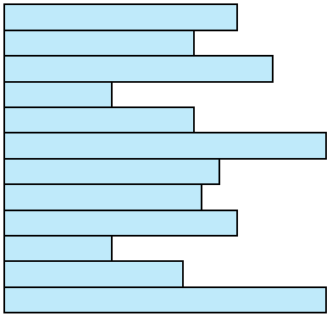
堆
5.2 文件组织和访问
堆文件
最简单的文件组织形式
按照到达的顺序收集数据
每条记录由一串数据组成
目的是积累大量数据并保存
通过穷举查找方法检索记录
变长记录
可变域集
按时间先后排序
Notes:
The least-complicated form of file organization may be termed the pile . Data are
collected in the order in which they arrive. Each record consists of one burst of
data. The purpose of the pile is simply to accumulate the mass of data and save it.
Records may have different fields, or similar fields in different orders. Thus, each
field should be self-describing, including a field name as well as a value. The length
of each field must be implicitly indicated by delimiters, explicitly included as a subfield,
or known as default for that field type.
Because there is no structure to the pile file, record access is by exhaustive
search. That is, if we wish to find a record that contains a particular field with a
particular value, it is necessary to examine each record in the pile until the desired
record is found or the entire file has been searched. If we wish to find all records
that contain a particular field or contain that field with a particular value, then the
entire file must be searched.
Pile files are encountered when data are collected and stored prior to processing
or when data are not easy to organize. This type of file uses space well when the
stored data vary in size and structure, is perfectly adequate for exhaustive searches,
and is easy to update. However, beyond these limited uses, this type of file is unsuitable
for most applications.

Slide 19
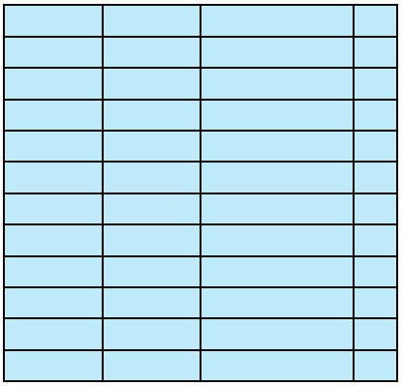
顺序文件
5.2 文件组织和访问
顺序文件
最常见的文件组织形式
记录有固定的格式；
所有记录的长度都相同：每个域的位置、长度等相同；
每个记录中有一个关键域，唯一标识这个记录
记录按照关键域存储和排序
通常用于批处理应用中
可以很容易地存储在磁盘和磁带
定长记录
固定顺序的固定域集
按关键字域排序
Notes:
The most common form of file structure is the sequential file. In this type of file,
a fixed format is used for records. All records are of the same length, consisting of
the same number of fixed-length fields in a particular order. Because the length and
position of each field are known, only the values of fields need to be stored; the field
name and length for each field are attributes of the file structure.
One particular field, usually the first field in each record, is referred to as the
key field . The key field uniquely identifies the record; thus key values for different
records are always different. Further, the records are stored in key sequence: alphabetical
order for a text key, and numerical order for a numerical key.
Sequential files are typically used in batch applications and are generally
optimum for such applications if they involve the processing of all the records (e.g.,
a billing or payroll application). The sequential file organization is the only one that
is easily stored on tape as well as disk.
For interactive applications that involve queries and/or updates of individual
records, the sequential file provides poor performance. Access requires the sequential
search of the file for a key match. If the entire file, or a large portion of the
file, can be brought into main memory at one time, more efficient search techniques
are possible. Nevertheless, considerable processing and delay are encountered to
access a record in a large sequential file. Additions to the file also present problems.
Typically, a sequential file is stored in simple sequential ordering of the records within
blocks. That is, the physical organization of the file on tape or disk directly matches
the logical organization of the file. In this case, the usual procedure is to place new
records in a separate pile file, called a log file or transaction file. Periodically, a batch
update is performed that merges the log file with the master file to produce a new file
in correct key sequence.
An alternative is to organize the sequential file physically as a linked list. One
or more records are stored in each physical block. Each block on disk contains a
pointer to the next block. The insertion of new records involves pointer manipulation
but does not require that the new records occupy a particular physical block
position. Thus, some added convenience is obtained at the cost of additional
processing and overhead.

Slide 20
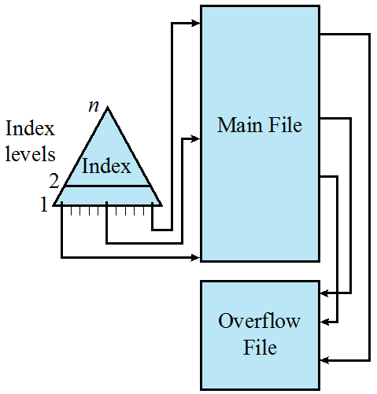
索引顺序文件
5.2 文件组织和访问
索引顺序文件
保留顺序文件的关键特征：记录按照关键域组织
增加了支持随机访问的索引和溢出文件
索引提供快速接近目标的查找能力
溢出文件类似日志文件，要往文件中插入记录时，可以将其放在溢出文件中，并由主文件中它(即所插入记录)的前一个记录通过指针指向；
可按批处理方式合并溢出文件
索引可以有多级
索引级
主文件
索引
溢出
文件
Notes:
A popular approach to overcoming the disadvantages of the sequential file is the
indexed sequential file. The indexed sequential file maintains the key characteristic
of the sequential file: Records are organized in sequence based on a key field. Two
features are added: an index to the file to support random access, and an overflow
file. The index provides a lookup capability to reach quickly the vicinity of a desired
record. The overflow file is similar to the log file used with a sequential file but is
integrated so that a record in the overflow file is located by following a pointer from
its predecessor record.
In the simplest indexed sequential structure, a single level of indexing is
used. The index in this case is a simple sequential file. Each record in the index file
consists of two fields: a key field, which is the same as the key field in the main file,
and a pointer into the main file. To find a specific field, the index is searched to find
the highest key value that is equal to or precedes the desired key value. The search
continues in the main file at the location indicated by the pointer.
To see the effectiveness of this approach, consider a sequential file with
1 million records. To search for a particular key value will require on average one-half
million record accesses. Now suppose that an index containing 1,000 entries
is constructed, with the keys in the index more or less evenly distributed over
the main file. Now it will take on average 500 accesses to the index file followed
by 500 accesses to the main file to find the record. The average search length is
reduced from 500,000 to 1,000.
Additions to the file are handled in the following manner: Each record in
the main file contains an additional field not visible to the application, which is a
pointer to the overflow file. When a new record is to be inserted into the file, it is
added to the overflow file. The record in the main file that immediately precedes
the new record in logical sequence is updated to contain a pointer to the new record
in the overflow file. If the immediately preceding record is itself in the overflow file,
then the pointer in that record is updated. As with the sequential file, the indexed
sequential file is occasionally merged with the overflow file in batch mode.
The indexed sequential file greatly reduces the time required to access a single
record, without sacrificing the sequential nature of the file. To process the entire file
sequentially, the records of the main file are processed in sequence until a pointer
to the overflow file is found, then accessing continues in the overflow file until a null
pointer is encountered, at which time accessing of the main file is resumed where it
left off.
To provide even greater efficiency in access, multiple levels of indexing can be
used. Thus the lowest level of index file is treated as a sequential file and a higher level
index file is created for that file. Consider again a file with 1 million records.
A lower-level index with 10,000 entries is constructed. A higher-level index into
the lower-level index of 100 entries can then be constructed. The search begins at
the higher-level index (average length = 50 accesses) to find an entry point into the
lower-level index. This index is then searched (average length = 50) to find an entry
point into the main file, which is then searched (average length = 50). Thus the average
length of search has been reduced from 500,000 to 1,000 to 150.

Slide 21
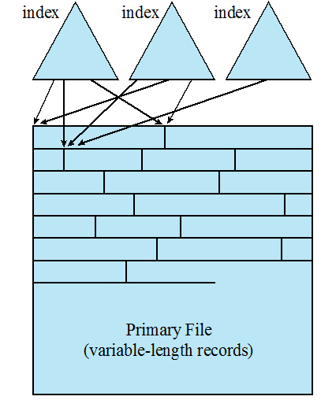
索引文件
5.2 文件组织和访问
索引文件
只能通过索引访问记录
可以使用变长度记录
完全索引包含主文件中每条记录的索引项
部分索引只包含有感兴趣域的记录的索引项
主要用于信息及时性要求比较严格且很少对所有数据进行处理的应用程序
例子是航空公司订票系统和商品库存控制系统
完全索引
完全索引
部分索引
原始文件
（变长记录）
Notes:
The indexed sequential file retains one limitation of the sequential file: Effective
processing is limited to that which is based on a single field of the file. For example,
when it is necessary to search for a record on the basis of some other attribute than
the key field, both forms of sequential file are inadequate. In some applications, the
flexibility of efficiently searching by various attributes is desirable.
To achieve this flexibility, a structure is needed that employs multiple indexes,
one for each type of field that may be the subject of a search. In the general indexed
file, the concept of sequentially and a single key are abandoned. Records are
accessed only through their indexes. The result is that there is now no restriction
on the placement of records as long as a pointer in at least one index refers to that
record. Furthermore, variable-length records can be employed.
Two types of indexes are used. An exhaustive index contains one entry for
every record in the main file. The index itself is organized as a sequential file for
ease of searching. A partial index contains entries to records where the field of
interest exists. With variable-length records, some records will not contain all fields.
When a new record is added to the main file, all of the index files must be updated.
Indexed files are used mostly in applications where timeliness of information
is critical and where data are rarely processed exhaustively. Examples are airline
reservation systems and inventory control systems.

Slide 22
5.2 文件组织和访问
直接文件或散列文件
直接访问磁盘中任意一个地址已知的数据块
使用基于关键字的散列
典型应用场景:
快速访问
固定长度的记录
一次只访问一条记录
例子:
目录
价格表
调度
名字列表
Notes:
The direct, or hashed, file exploits the capability found on disks to access directly any
block of a known address. As with sequential and indexed sequential files, a key field
is required in each record. However, there is no concept of sequential ordering here.
The direct file makes use of hashing on the key value. This function is explained
in Appendix F . Figure F.1b shows the type of hashing organization with an overflow
file that is typically used in a hash file.
Direct files are often used where very rapid access is required, where fixed length
records are used, and where records are always accessed one at a time.
Examples are directories, pricing tables, schedules, and name lists.

Slide 23
5.3 文件目录
文件目录里每个文件项包含的信息（见P350表12.1）
目录单元
基本
信息
地址
信息
访问控制信息
使用
信息
Notes:
Associated with any file management system and collection of files is a file directory.
The directory contains information about the files, including attributes, location,
and ownership. Much of this information, especially that concerned with storage,
is managed by the operating system. The directory is itself a file, accessible by various
file management routines. Although some of the information in directories is
available to users and applications, this is generally provided indirectly by system
routines.
Table 12.1 suggests the information typically stored in the directory for each
file in the system. From the user’s point of view, the directory provides a mapping
between file names, known to users and applications, and the files themselves. Thus,
each file entry includes the name of the file. Virtually all systems deal with different
types of files and different file organizations, and this information is also provided.
An important category of information about each file concerns its storage, including
its location and size. In shared systems, it is also important to provide information
that is used to control access to the file. Typically, one user is the owner of the file
and may grant certain access privileges to other users. Finally, usage information is
needed to manage the current use of the file and to record the history of its usage.

Slide 24
5.3 文件目录
基本信息
文件名 由创建者（用户或程序）选择的名字，在同一个目录中必须唯一 文件类型 如文本文件、二进制文件、加载模块等 文件组织 供那些支持不同组织形式的系统使用
地址信息
卷 指示存储文件的设备 起始地址 文件在辅存中的起始物理地址（如磁盘的柱面、磁道和扇区） 使用大小 文件的当前大小，单位为字节、字或块 分配大小 文件的最大尺寸
Notes:
Associated with any file management system and collection of files is a file directory.
The directory contains information about the files, including attributes, location,
and ownership. Much of this information, especially that concerned with storage,
is managed by the operating system. The directory is itself a file, accessible by various
file management routines. Although some of the information in directories is
available to users and applications, this is generally provided indirectly by system
routines.
Table 12.1 suggests the information typically stored in the directory for each
file in the system. From the user’s point of view, the directory provides a mapping
between file names, known to users and applications, and the files themselves. Thus,
each file entry includes the name of the file. Virtually all systems deal with different
types of files and different file organizations, and this information is also provided.
An important category of information about each file concerns its storage, including
its location and size. In shared systems, it is also important to provide information
that is used to control access to the file. Typically, one user is the owner of the file
and may grant certain access privileges to other users. Finally, usage information is
needed to manage the current use of the file and to record the history of its usage.

Slide 25
5.3 文件目录
访问控制信息
所有者 文件主，可以授权或拒绝其他用户的访问、改变给予他们的权限 访问信息 该单元的最简单形式包括每个授权用户的用户名和口令 权限信息 控制读、写、执行及在网上传输
使用信息
数据创建 文件首次放到目录中的时间 创建者身份 通常是当前所有者，但不一定必须是当前所有者 最后一次访问的日期 最后一次读取文件内容的时间 最后一次读用户的身份 最后一次执行读操作的用户 最后一次修改的日期 最后一次修改、插入或删除文件内容的时间 最后一次修改者的身份 最后一次进行修改操作的用户 最后一次备份的日期 最后一次把文件备份到另一个存储介质中的日期 当前使用 当前文件活动的信息，如打开文件的进程、加锁等
Notes:
Associated with any file management system and collection of files is a file directory.
The directory contains information about the files, including attributes, location,
and ownership. Much of this information, especially that concerned with storage,
is managed by the operating system. The directory is itself a file, accessible by various
file management routines. Although some of the information in directories is
available to users and applications, this is generally provided indirectly by system
routines.
Table 12.1 suggests the information typically stored in the directory for each
file in the system. From the user’s point of view, the directory provides a mapping
between file names, known to users and applications, and the files themselves. Thus,
each file entry includes the name of the file. Virtually all systems deal with different
types of files and different file organizations, and this information is also provided.
An important category of information about each file concerns its storage, including
its location and size. In shared systems, it is also important to provide information
that is used to control access to the file. Typically, one user is the owner of the file
and may grant certain access privileges to other users. Finally, usage information is
needed to manage the current use of the file and to record the history of its usage.

Slide 26
5.3 文件目录
目录操作类型
查找
创建
文件
删除
文件
显示
目录
修改
目录
Notes:
To understand the requirements for a file structure, it is helpful to consider
the types of operations that may be performed on the directory:
• Search: When a user or application references a file, the directory must be
searched to find the entry corresponding to that file.
• Create file: When a new file is created, an entry must be added to the directory.
• Delete file: When a file is deleted, an entry must be removed from the directory.
• List directory: All or a portion of the directory may be requested. Generally,
this request is made by a user and results in a listing of all files owned by that
user, plus some of the attributes of each file (e.g., type, access control information,
usage information).
• Update directory: Because some file attributes are stored in the directory, a
change in one of these attributes requires a change in the corresponding directory
entry.
The simple list is not suited to supporting these operations. Consider the needs
of a single user. The user may have many types of files, including word-processing
text files, graphic files, spreadsheets, and so on. The user may like to have these
organized by project, by type, or in some other convenient way. If the directory is a
simple sequential list, it provides no help in organizing the files and forces the user
to be careful not to use the same name for two different types of files. The problem
is much worse in a shared system. Unique naming becomes a serious problem.
Furthermore, it is difficult to conceal portions of the overall directory from users
when there is no inherent structure in the directory.

Slide 27
5.3 文件目录
目录结构
单级结构
两级结构
层次结构
树状结构
无循环图结构
Notes:
To understand the requirements for a file structure, it is helpful to consider
the types of operations that may be performed on the directory:
• Search: When a user or application references a file, the directory must be
searched to find the entry corresponding to that file.
• Create file: When a new file is created, an entry must be added to the directory.
• Delete file: When a file is deleted, an entry must be removed from the directory.
• List directory: All or a portion of the directory may be requested. Generally,
this request is made by a user and results in a listing of all files owned by that
user, plus some of the attributes of each file (e.g., type, access control information,
usage information).
• Update directory: Because some file attributes are stored in the directory, a
change in one of these attributes requires a change in the corresponding directory
entry.
The simple list is not suited to supporting these operations. Consider the needs
of a single user. The user may have many types of files, including word-processing
text files, graphic files, spreadsheets, and so on. The user may like to have these
organized by project, by type, or in some other convenient way. If the directory is a
simple sequential list, it provides no help in organizing the files and forces the user
to be careful not to use the same name for two different types of files. The problem
is much worse in a shared system. Unique naming becomes a serious problem.
Furthermore, it is difficult to conceal portions of the overall directory from users
when there is no inherent structure in the directory.

Slide 28
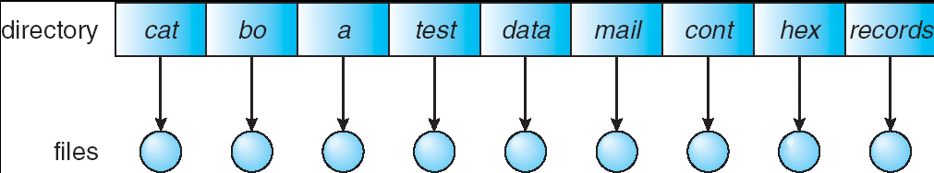
5.3 文件目录
单级结构/简单列表
在整个文件系统中只建立一张目录表，其中每个目录项对应一个文件。
主要优点是实现简单。
缺点：不允许文件重名；文件查找速度慢。
Notes:
To understand the requirements for a file structure, it is helpful to consider
the types of operations that may be performed on the directory:
• Search: When a user or application references a file, the directory must be
searched to find the entry corresponding to that file.
• Create file: When a new file is created, an entry must be added to the directory.
• Delete file: When a file is deleted, an entry must be removed from the directory.
• List directory: All or a portion of the directory may be requested. Generally,
this request is made by a user and results in a listing of all files owned by that
user, plus some of the attributes of each file (e.g., type, access control information,
usage information).
• Update directory: Because some file attributes are stored in the directory, a
change in one of these attributes requires a change in the corresponding directory
entry.
The simple list is not suited to supporting these operations. Consider the needs
of a single user. The user may have many types of files, including word-processing
text files, graphic files, spreadsheets, and so on. The user may like to have these
organized by project, by type, or in some other convenient way. If the directory is a
simple sequential list, it provides no help in organizing the files and forces the user
to be careful not to use the same name for two different types of files. The problem
is much worse in a shared system. Unique naming becomes a serious problem.
Furthermore, it is difficult to conceal portions of the overall directory from users
when there is no inherent structure in the directory.

Slide 29
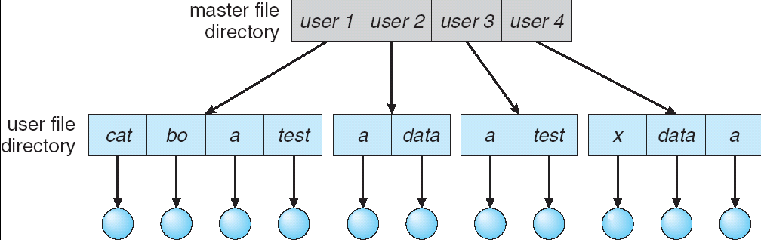
5.3 文件目录
两级结构
主目录：每个用户一个目录项，提供地址和访问控制信息
用户目录：用户文件的简单列表，文件名称须唯一
Notes:
To understand the requirements for a file structure, it is helpful to consider
the types of operations that may be performed on the directory:
• Search: When a user or application references a file, the directory must be
searched to find the entry corresponding to that file.
• Create file: When a new file is created, an entry must be added to the directory.
• Delete file: When a file is deleted, an entry must be removed from the directory.
• List directory: All or a portion of the directory may be requested. Generally,
this request is made by a user and results in a listing of all files owned by that
user, plus some of the attributes of each file (e.g., type, access control information,
usage information).
• Update directory: Because some file attributes are stored in the directory, a
change in one of these attributes requires a change in the corresponding directory
entry.
The simple list is not suited to supporting these operations. Consider the needs
of a single user. The user may have many types of files, including word-processing
text files, graphic files, spreadsheets, and so on. The user may like to have these
organized by project, by type, or in some other convenient way. If the directory is a
simple sequential list, it provides no help in organizing the files and forces the user
to be careful not to use the same name for two different types of files. The problem
is much worse in a shared system. Unique naming becomes a serious problem.
Furthermore, it is difficult to conceal portions of the overall directory from users
when there is no inherent structure in the directory.

Slide 30
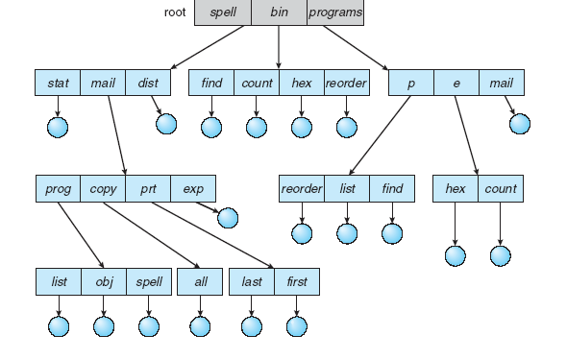
5.3 文件目录
树状结构
每一级目录可以包含文件，也可以包含下一级目录。
只有一个根目录，而且除根目录外，其余每个目录或者文件都有唯一的一个上级目录。
单个主目录
多个子目录
主目录
子目录
子目录
子目录
文件
子目录
文件
文件
Notes:
To understand the requirements for a file structure, it is helpful to consider
the types of operations that may be performed on the directory:
• Search: When a user or application references a file, the directory must be
searched to find the entry corresponding to that file.
• Create file: When a new file is created, an entry must be added to the directory.
• Delete file: When a file is deleted, an entry must be removed from the directory.
• List directory: All or a portion of the directory may be requested. Generally,
this request is made by a user and results in a listing of all files owned by that
user, plus some of the attributes of each file (e.g., type, access control information,
usage information).
• Update directory: Because some file attributes are stored in the directory, a
change in one of these attributes requires a change in the corresponding directory
entry.
The simple list is not suited to supporting these operations. Consider the needs
of a single user. The user may have many types of files, including word-processing
text files, graphic files, spreadsheets, and so on. The user may like to have these
organized by project, by type, or in some other convenient way. If the directory is a
simple sequential list, it provides no help in organizing the files and forces the user
to be careful not to use the same name for two different types of files. The problem
is much worse in a shared system. Unique naming becomes a serious problem.
Furthermore, it is difficult to conceal portions of the overall directory from users
when there is no inherent structure in the directory.

Slide 31
5.3 文件目录
树状结构
路径名
任何文件可以按照根目录或主目录向下到各个分支，最后达到该文件的路径来定位。
多个文件可以同名，只要保证它们的路径名是唯一的即可。
工作目录（working directory）
对于用户，总有一个当前路径与之相关联，称作工作目录。
多个文件可以同名，只要保证它们的路径名是唯一的即可。
绝对路径：从根目录开始指定的目录
相对路径：从当前工作目录开始
Notes:
To understand the requirements for a file structure, it is helpful to consider
the types of operations that may be performed on the directory:
• Search: When a user or application references a file, the directory must be
searched to find the entry corresponding to that file.
• Create file: When a new file is created, an entry must be added to the directory.
• Delete file: When a file is deleted, an entry must be removed from the directory.
• List directory: All or a portion of the directory may be requested. Generally,
this request is made by a user and results in a listing of all files owned by that
user, plus some of the attributes of each file (e.g., type, access control information,
usage information).
• Update directory: Because some file attributes are stored in the directory, a
change in one of these attributes requires a change in the corresponding directory
entry.
The simple list is not suited to supporting these operations. Consider the needs
of a single user. The user may have many types of files, including word-processing
text files, graphic files, spreadsheets, and so on. The user may like to have these
organized by project, by type, or in some other convenient way. If the directory is a
simple sequential list, it provides no help in organizing the files and forces the user
to be careful not to use the same name for two different types of files. The problem
is much worse in a shared system. Unique naming becomes a serious problem.
Furthermore, it is difficult to conceal portions of the overall directory from users
when there is no inherent structure in the directory.

Slide 32
5.3 文件目录
树状结构
Notes:
Users need to be able to refer to a file by a symbolic name. Clearly, each file in the
system must have a unique name in order that file references be unambiguous. On
the other hand, it is an unacceptable burden on users to require that they provide
unique names, especially in a shared system.
The use of a tree-structured directory minimizes the difficulty in assigning
unique names. Any file in the system can be located by following a path from the
root or master directory down various branches until the file is reached. The series
of directory names, culminating in the file name itself, constitutes a pathname for
the file. As an example, the file in the lower left-hand corner of Figure 12.7 . has the
pathname User_B/Word/Unit_A/ABC . The slash is used to delimit names in the
sequence. The name of the master directory is implicit, because all paths start at
that directory. Note that it is perfectly acceptable to have several files with the same
file name, as long as they have unique pathnames, which is equivalent to saying
that the same file name may be used in different directories. In our example, there
is another file in the system with the file name ABC, but that has the pathname
/User_B/Draw/ABC .
Although the pathname facilitates the selection of file names, it would be awkward
for a user to have to spell out the entire pathname every time a reference is
made to a file. Typically, an interactive user or a process has associated with it a
current directory, often referred to as the working directory . Files are then referenced
relative to the working directory. For example, if the working directory for
user B is “Word,” then the pathname Unit_A/ABC is sufficient to identify the file
in the lower left-hand corner of Figure 12.7 . When an interactive user logs on, or
when a process is created, the default for the working directory is the user home
directory. During execution, the user can navigate up or down in the tree to change
to a different working directory.

Slide 33
5.3 文件目录
无循环图结构
在树型目录的基础上，允许多个目录项指向同一个数据文件或者目录文件，实现了目录或者数据文件的共享。
不同的主目录可以共享一个文件和分目录，而不是各自拥有文件或分目录的拷贝。
Unix的目录结构即属于无循环图结构
目录项的删除
若对应的文件只有一个引用时，同时删除该文件。
若对应的文件存在多个引用时，只删除引用，而不删除文件。只有在所有文件引用都被删除后才删除文件。
Notes:
To understand the requirements for a file structure, it is helpful to consider
the types of operations that may be performed on the directory:
• Search: When a user or application references a file, the directory must be
searched to find the entry corresponding to that file.
• Create file: When a new file is created, an entry must be added to the directory.
• Delete file: When a file is deleted, an entry must be removed from the directory.
• List directory: All or a portion of the directory may be requested. Generally,
this request is made by a user and results in a listing of all files owned by that
user, plus some of the attributes of each file (e.g., type, access control information,
usage information).
• Update directory: Because some file attributes are stored in the directory, a
change in one of these attributes requires a change in the corresponding directory
entry.
The simple list is not suited to supporting these operations. Consider the needs
of a single user. The user may have many types of files, including word-processing
text files, graphic files, spreadsheets, and so on. The user may like to have these
organized by project, by type, or in some other convenient way. If the directory is a
simple sequential list, it provides no help in organizing the files and forces the user
to be careful not to use the same name for two different types of files. The problem
is much worse in a shared system. Unique naming becomes a serious problem.
Furthermore, it is difficult to conceal portions of the overall directory from users
when there is no inherent structure in the directory.

Slide 34
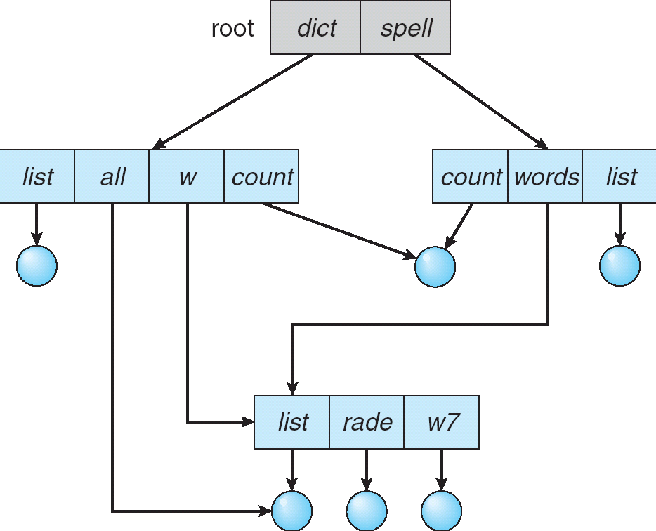
5.3 文件目录
无循环图结构
Notes:
To understand the requirements for a file structure, it is helpful to consider
the types of operations that may be performed on the directory:
• Search: When a user or application references a file, the directory must be
searched to find the entry corresponding to that file.
• Create file: When a new file is created, an entry must be added to the directory.
• Delete file: When a file is deleted, an entry must be removed from the directory.
• List directory: All or a portion of the directory may be requested. Generally,
this request is made by a user and results in a listing of all files owned by that
user, plus some of the attributes of each file (e.g., type, access control information,
usage information).
• Update directory: Because some file attributes are stored in the directory, a
change in one of these attributes requires a change in the corresponding directory
entry.
The simple list is not suited to supporting these operations. Consider the needs
of a single user. The user may have many types of files, including word-processing
text files, graphic files, spreadsheets, and so on. The user may like to have these
organized by project, by type, or in some other convenient way. If the directory is a
simple sequential list, it provides no help in organizing the files and forces the user
to be careful not to use the same name for two different types of files. The problem
is much worse in a shared system. Unique naming becomes a serious problem.
Furthermore, it is difficult to conceal portions of the overall directory from users
when there is no inherent structure in the directory.

Slide 35
5.4 文件共享
允许多个用户之间共享文件时出现的两个问题:
访问权限
并发控制
Notes:
In a multiuser system, there is almost always a requirement for allowing files to be
shared among a number of users. Two issues arise: access rights and the management
of simultaneous access.

Slide 36
5.4 文件共享
用户对文件的代表性访问权限
无（None）
不允许用户读取包含该文件的用户目录
知道（Knowledge）
用户可以确定文件的存在性、所有者，可以向所有者请求更多地访问权限
执行（Execution）
用户可以加载并执行程序，但不能复制
读（Reading）
用户可以读取文件，包括复制和执行
追加（Appending）
用户可以将数据添加到文件中，但不能修改或删除文件内容
更新（Updating）
用户可以修改、删除和添加文件内容
改变保护（Changing protection）
用户可以更改授予其他用户的访问权限
删除（Deletion）
用户可以从文件系统中删除该文件
Notes:
The file system should provide a flexible tool for allowing extensive file sharing
among users. The file system should provide a number of options so that the way
in which a particular file is accessed can be controlled. Typically, users or groups
of users are granted certain access rights to a file. A wide range of access rights has
been used. The following list is representative of access rights that can be assigned
to a particular user for a particular file:
• None: The user may not even learn of the existence of the file, much less
access it. To enforce this restriction, the user would not be allowed to read the
user directory that includes this file.
• Knowledge: The user can determine that the file exists and who its owner is.
The user is then able to petition the owner for additional access rights.
• Execution: The user can load and execute a program but cannot copy it.
Proprietary programs are often made accessible with this restriction.
• Reading: The user can read the file for any purpose, including copying and
execution. Some systems are able to enforce a distinction between viewing
and copying. In the former case, the contents of the file can be displayed to the
user, but the user has no means for making a copy.
• Appending: The user can add data to the file, often only at the end, but cannot
modify or delete any of the file’s contents. This right is useful in collecting data
from a number of sources.
• Updating: The user can modify, delete, and add to the file’s data. This normally
includes writing the file initially, rewriting it completely or in part, and removing
all or a portion of the data. Some systems distinguish among different
degrees of updating.
• Changing protection: The user can change the access rights granted to other
users. Typically, this right is held only by the owner of the file. In some systems,
the owner can extend this right to others. To prevent abuse of this mechanism,
the file owner will typically be able to specify which rights can be changed by
the holder of this right.
• Deletion: The user can delete the file from the file system.
These rights can be considered to constitute a hierarchy, with each right implying
those that precede it. Thus, if a particular user is granted the updating right for a
particular file, then that user is also granted the following rights: knowledge, execution,
reading, and appending.

Slide 37
5.4 文件共享
用户对文件的访问权限与用户身份相关
文件主
通常是文件的初始创建者
全部权限
给其他用户授权
特定用户
由用户ID指定的单个用户
组用户
非单独定义的一组用户
全部
有权访问该系统的所有用户
公共文件
Notes:
One user is designated as owner of a given file, usually the person who initially
created a file. The owner has all of the access rights listed previously and may grant
rights to others. Access can be provided to different classes of users:
• Specific user: Individual users who are designated by user ID
• User groups: A set of users who are not individually defined. The system must
have some way of keeping track of the membership of user groups.
• All: All users who have access to this system. These are public files.

Slide 38
5.4 文件共享
文件共享的实现
一份物理存储
多个别名
在Unix操作系统上，可通过链接实现文件共享
链接分类
硬链接 Hard Link
软连接 Soft Link
基于索引结点
基于符号链接
Notes:
To understand the requirements for a file structure, it is helpful to consider
the types of operations that may be performed on the directory:
• Search: When a user or application references a file, the directory must be
searched to find the entry corresponding to that file.
• Create file: When a new file is created, an entry must be added to the directory.
• Delete file: When a file is deleted, an entry must be removed from the directory.
• List directory: All or a portion of the directory may be requested. Generally,
this request is made by a user and results in a listing of all files owned by that
user, plus some of the attributes of each file (e.g., type, access control information,
usage information).
• Update directory: Because some file attributes are stored in the directory, a
change in one of these attributes requires a change in the corresponding directory
entry.
The simple list is not suited to supporting these operations. Consider the needs
of a single user. The user may have many types of files, including word-processing
text files, graphic files, spreadsheets, and so on. The user may like to have these
organized by project, by type, or in some other convenient way. If the directory is a
simple sequential list, it provides no help in organizing the files and forces the user
to be careful not to use the same name for two different types of files. The problem
is much worse in a shared system. Unique naming becomes a serious problem.
Furthermore, it is difficult to conceal portions of the overall directory from users
when there is no inherent structure in the directory.

Slide 39
5.4 文件共享
硬链接
多个文件名链接到同一个索引结点
索引节点的引用计数记录在索引节点的链接计数中，若其减至0，则文件被删除。
文件名 索引指针
F1
I节点
F2
F3
I节点
…
…
共享索引节点
User1的目录文件
Count
物理地址
文件
文件名 索引指针
H1
I节点
H2
H3
I节点
…
…
User2的目录文件

Slide 40
5.4 文件共享
硬链接
链接文件和被链接文件必须位于同一个文件系统中
不能建立指向目录的硬链接
例：$ ln a b
a, b链接到同一个索引节点
删除b,则a不受影响，索引节点引用计数减少1
修改b, 则a也修改了
Notes:
To understand the requirements for a file structure, it is helpful to consider
the types of operations that may be performed on the directory:
• Search: When a user or application references a file, the directory must be
searched to find the entry corresponding to that file.
• Create file: When a new file is created, an entry must be added to the directory.
• Delete file: When a file is deleted, an entry must be removed from the directory.
• List directory: All or a portion of the directory may be requested. Generally,
this request is made by a user and results in a listing of all files owned by that
user, plus some of the attributes of each file (e.g., type, access control information,
usage information).
• Update directory: Because some file attributes are stored in the directory, a
change in one of these attributes requires a change in the corresponding directory
entry.
The simple list is not suited to supporting these operations. Consider the needs
of a single user. The user may have many types of files, including word-processing
text files, graphic files, spreadsheets, and so on. The user may like to have these
organized by project, by type, or in some other convenient way. If the directory is a
simple sequential list, it provides no help in organizing the files and forces the user
to be careful not to use the same name for two different types of files. The problem
is much worse in a shared system. Unique naming becomes a serious problem.
Furthermore, it is difficult to conceal portions of the overall directory from users
when there is no inherent structure in the directory.

Slide 41
5.4 文件共享
软链接/符号链接（symbolic link）
特殊类型的文件，其链接内容是另一个目录或文件的路径。
比对硬链接的限制？（跨盘，目录）
建立符号链接文件，并不影响原文件——它们是独立的文件。
例：$ ln –s a b
为a创建一个符号链接b
rm b：a不受影响
rm a：a不存在，b能被控制但无法访问
缺点
空间和时间开销更大
Notes:
To understand the requirements for a file structure, it is helpful to consider
the types of operations that may be performed on the directory:
• Search: When a user or application references a file, the directory must be
searched to find the entry corresponding to that file.
• Create file: When a new file is created, an entry must be added to the directory.
• Delete file: When a file is deleted, an entry must be removed from the directory.
• List directory: All or a portion of the directory may be requested. Generally,
this request is made by a user and results in a listing of all files owned by that
user, plus some of the attributes of each file (e.g., type, access control information,
usage information).
• Update directory: Because some file attributes are stored in the directory, a
change in one of these attributes requires a change in the corresponding directory
entry.
The simple list is not suited to supporting these operations. Consider the needs
of a single user. The user may have many types of files, including word-processing
text files, graphic files, spreadsheets, and so on. The user may like to have these
organized by project, by type, or in some other convenient way. If the directory is a
simple sequential list, it provides no help in organizing the files and forces the user
to be careful not to use the same name for two different types of files. The problem
is much worse in a shared system. Unique naming becomes a serious problem.
Furthermore, it is difficult to conceal portions of the overall directory from users
when there is no inherent structure in the directory.

Slide 42
5.4 文件共享
硬连接与软链接的对比
硬链接
软链接
只允许文件链接，不允许目录链接；
只允许在同一个文件系统范围内进行，不允许跨文件系统。
删除文件时，如果还有其它链接链至该文件，则该文件不能被删除。
访问速度相对慢，但适用范围和灵活性更大。
允许目录链接，允许运行在不同的文件系统间进行链接，这些文件系统可以在相同或不同的计算机上。
被链接文件的删除和符号链接的删除是相互独立的
Notes:
To understand the requirements for a file structure, it is helpful to consider
the types of operations that may be performed on the directory:
• Search: When a user or application references a file, the directory must be
searched to find the entry corresponding to that file.
• Create file: When a new file is created, an entry must be added to the directory.
• Delete file: When a file is deleted, an entry must be removed from the directory.
• List directory: All or a portion of the directory may be requested. Generally,
this request is made by a user and results in a listing of all files owned by that
user, plus some of the attributes of each file (e.g., type, access control information,
usage information).
• Update directory: Because some file attributes are stored in the directory, a
change in one of these attributes requires a change in the corresponding directory
entry.
The simple list is not suited to supporting these operations. Consider the needs
of a single user. The user may have many types of files, including word-processing
text files, graphic files, spreadsheets, and so on. The user may like to have these
organized by project, by type, or in some other convenient way. If the directory is a
simple sequential list, it provides no help in organizing the files and forces the user
to be careful not to use the same name for two different types of files. The problem
is much worse in a shared system. Unique naming becomes a serious problem.
Furthermore, it is difficult to conceal portions of the overall directory from users
when there is no inherent structure in the directory.

Slide 43
5.5 记录组块
块是与辅存进行I/O操作的基本单位
为执行I/O，记录必须组织成块
对于给定的块大小，有三种组块方法:
定长组块（Fixed-Length Blocking ）
– 使用定长的记录，且若干完整的记录保存在一个块中。
内部碎片 – 每个块的末尾可能存在的未使用的空间
变长非跨越式组块（Variable-Length Unspanned Blocking） – 使用变长记录，但并不采用跨越式方式，存在内部碎片。
变长跨越式组块（Variable-Length Spanned Blocking）
– 使用变长的记录，并紧缩到块中，使得块中不存在未使用的空间
Notes:
As indicated in Figure 12.2 , records are the logical unit of access of a structured file,
whereas blocks are the unit of I/O with secondary storage. For I/O to be performed,
records must be organized as blocks.
There are several issues to consider. First, should blocks be of fixed or variable
length? On most systems, blocks are of fixed length. This simplifies I/O, buffer
allocation in main memory, and the organization of blocks on secondary storage.
Second, what should the relative size of a block be compared to the average record
size? The trade-off is this: The larger the block, the more records that are passed
in one I/O operation. If a file is being processed or searched sequentially, this is an
advantage, because the number of I/O operations is reduced by using larger blocks,
thus speeding up processing. On the other hand, if records are being accessed randomly
and no particular locality of reference is observed, then larger blocks result in
the unnecessary transfer of unused records. However, combining the frequency of
sequential operations with the potential for locality of reference, we can say that the
I/O transfer time is reduced by using larger blocks. The competing concern is that
larger blocks require larger I/O buffers, making buffer management more difficult.
Given the size of a block, there are three methods of blocking that can be used:
• Fixed blocking: Fixed-length records are used, and an integral number of
records are stored in a block. There may be unused space at the end of each
block. This is referred to as internal fragmentation.
• Variable-length spanned blocking: Variable-length records are used and are
packed into blocks with no unused space. Thus, some records must span two
blocks, with the continuation indicated by a pointer to the successor block.
Variable-length unspanned blocking: Variable-length records are used, but
spanning is not employed. There is wasted space in most blocks because of the
inability to use the remainder of a block if the next record is larger than the
remaining unused space.

Slide 44
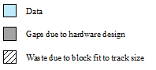
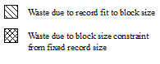
5.5 记录组块
磁道1
磁道2
固定组块
数据
磁道1
由硬件设计产生的间隙
由于适应磁道大小而产生的浪费
磁道2
由于记录适应块大小而产生的浪费
由于固定记录大小对块大小的约束而产生的浪费
可变组块： 跨越式
磁道1
磁道2
可变组块： 非跨越式
Notes:
Figure 12.8 illustrates these methods assuming that a file is stored in sequential
blocks on a disk. The figure assumes that the file is large enough to span two
tracks. The effect would not be changed if some other file allocation scheme were
used (see Section 12.6 ).
Fixed blocking is the common mode for sequential files with fixed-length
records. Variable-length spanned blocking is efficient of storage and does not limit
the size of records. However, this technique is difficult to implement.
Records that span two blocks require two I/O operations, and files are difficult to update, regardless
of the organization. Variable-length unspanned blocking results in wasted space
and limits record size to the size of a block.

Slide 45
5.6 辅存管理
空闲空间管理
卷
文件
分配
Notes:
On secondary storage, a file consists of a collection of blocks. The operating system
or file management system is responsible for allocating blocks to files. This raises
two management issues. First, space on secondary storage must be allocated to files,
and second, it is necessary to keep track of the space available for allocation. We
will see that these two tasks are related; that is, the approach taken for file allocation
may influence the approach taken for free space management. Further, we will
see that there is an interaction between file structure and allocation policy.
We begin this section by looking at alternatives for file allocation on a single
disk. Then we look at the issue of free space management, and finally we discuss
reliability.
Several issues are involved in file allocation:
1. When a new file is created, is the maximum space required for the file allocated
at once?
2. Space is allocated to a file as one or more contiguous units, which we shall
refer to as portions. That is, a portion is a contiguous set of allocated blocks.
The size of a portion can range from a single block to the entire file. What size
of portion should be used for file allocation?
3. What sort of data structure or table is used to keep track of the portions
assigned to a file? An example of such a structure is a file allocation table
(FAT) , found on DOS and some other systems.

Slide 46
5.6.1 文件分配
在辅存中，文件由许多块组成
操作系统或文件管理系统负责为文件分配块
文件分配采用的方法可能会影响到空闲空间管理的方法
给文件分配的是一个或多个分区（portions，一组连续的已分配块)
文件分配表（File allocation table ，FAT)
用于跟踪分配给文件的分区的数据结构
Notes:
On secondary storage, a file consists of a collection of blocks. The operating system
or file management system is responsible for allocating blocks to files. This raises
two management issues. First, space on secondary storage must be allocated to files,
and second, it is necessary to keep track of the space available for allocation. We
will see that these two tasks are related; that is, the approach taken for file allocation
may influence the approach taken for free space management. Further, we will
see that there is an interaction between file structure and allocation policy.
We begin this section by looking at alternatives for file allocation on a single
disk. Then we look at the issue of free space management, and finally we discuss
reliability.
Several issues are involved in file allocation:
1. When a new file is created, is the maximum space required for the file allocated
at once?
2. Space is allocated to a file as one or more contiguous units, which we shall
refer to as portions. That is, a portion is a contiguous set of allocated blocks.
The size of a portion can range from a single block to the entire file. What size
of portion should be used for file allocation?
3. What sort of data structure or table is used to keep track of the portions
assigned to a file? An example of such a structure is a file allocation table
(FAT) , found on DOS and some other systems.

Slide 47
5.6.1 文件分配
预分配与动态分配
预分配策略要求在文件创建时声明文件的最大尺寸
对于许多应用程序，很难可靠地估计文件的最大尺寸
用户和应用程序往往估大文件的最大尺寸，从而造成浪费
动态分配只有在需要时才给文件分配空间
Notes:
A preallocation policy requires
that the maximum size of a file be declared at the time of the file creation request.
In a number of cases, such as program compilations, the production of summary
data files, or the transfer of a file from another system over a communications
network, this value can be reliably estimated. However, for many applications, it
is difficult if not impossible to estimate reliably the maximum potential size of the
file. In those cases, users and application programmers would tend to overestimate
file size so as not to run out of space. This clearly is wasteful from the point of view
of secondary storage allocation. Thus, there are advantages to the use of dynamic
allocation, which allocates space to a file in portions as needed.

Slide 48

5.6.1 文件分配
分区大小
在选择分区大小时，需要折中考虑单个文件的效率和整个系统的效率
分区大小的考虑因素
邻近空间可以提高性能，特别是对于Retrieve_Next操作，以及面向事务的操作系统中运行的事务
数量较多的小分区会增加用于管理分配信息的表的大小
使用固定大小的分区（例如块）可以简化空间的再分配
使用可变大小的分区或固定大小的小分区，可减少超额分配导致的未使用存储空间的浪费
Notes:
The second issue listed is that of the size of the portion allocated to a
file. At one extreme, a portion large enough to hold the entire file is allocated. At the
other extreme, space on the disk is allocated one block at a time. In choosing a portion
size, there is a trade-off between efficiency from the point of view of a single file versus
overall system efficiency. [WIED87] lists four items to be considered in the trade-off:
1. Contiguity of space increases performance, especially for Retrieve_Next
operations, and greatly for transactions running in a transaction-oriented
operating system.
2. Having a large number of small portions increases the size of tables needed to
manage the allocation information.
3. Having fixed-size portions (e.g., blocks) simplifies the reallocation of space.
4. Having variable-size or small fixed-size portions minimizes waste of unused
storage due to overallocation.

Slide 49
5.6.1 文件分配
分区大小的选择策略
大小可变的大规模连续分区
块
性能较好
避免浪费
文件分配表较小
小的固定分区能提供更大的灵活性
需要较大表或更复杂的结构来管理块的分配情况
邻近性不再是主要目的
主要目的是根据需要来分配块
空间难以再次利用
Notes:
Of course, these items interact and must be considered together. The result is
that there are two major alternatives:
• Variable, large contiguous portions: This will provide better performance. The
variable size avoids waste, and the file allocation tables are small. However,
space is hard to reuse.
• Blocks : Small fixed portions provide greater flexibility. They may require
large tables or complex structures for their allocation. Contiguity has been
abandoned as a primary goal; blocks are allocated as needed.
Either option is compatible with preallocation or dynamic allocation. In
the case of variable, large contiguous portions, a file is preallocated one contiguous
group of blocks. This eliminates the need for a file allocation table; all that is
required is a pointer to the first block and the number of blocks allocated. In the
case of blocks, all of the portions required are allocated at one time. This means that
the file allocation table for the file will remain of fixed size, because the number of
blocks allocated is fixed.
With variable-size portions, we need to be concerned with the fragmentation
of free space. This issue was faced when we considered partitioned main memory in
Chapter 7 . The following are possible alternative strategies:
• First fit: Choose the first unused contiguous group of blocks of sufficient size
from a free block list.
• Best fit: Choose the smallest unused group that is of sufficient size.
• Nearest fit: Choose the unused group of sufficient size that is closest to the
previous allocation for the file to increase locality.
It is not clear which strategy is best. The difficulty in modeling alternative
strategies is that so many factors interact, including types of files, pattern of file
access, degree of multiprogramming, other performance factors in the system, disk
caching, disk scheduling, and so on.

Slide 50
5.6.1 文件分配
文件分配方法
 | 连续 | 链式 | 索引
是否预分配 | 需要 | 可能 | 可能
分区大小是固定还是可变 | 可变 | 固定块 | 固定块 | 可变
分区大小 | 大 | 小 | 小 | 中
分配频率 | 一次 | 低到高 | 高 | 低
分配需要的时间 | 中 | 长 | 短 | 中
文件分配表的大小 | 一个表项 | 一个表项 | 大 | 中
Notes:
Table 12.2 File Allocation Methods
Having looked at the issues of preallocation versus
dynamic allocation and portion size, we are in a position to consider specific file
allocation methods. Three methods are in common use: contiguous, chained, and
indexed. Table 12.2 summarizes some of the characteristics of each method.

Slide 51
5.6.1 文件分配
连续分配
大小可变的预分配策略：创建文件时，分配一组连续的块
文件分配表里每个文件只需一个表项：说明起始块和长度
适合顺序文件，检索容易
问题
外部碎片
预分配可能带来的问题
Notes:
With contiguous allocation , a single contiguous set of blocks is allocated to a
file at the time of file creation ( Figure 12.9 ). Thus, this is a preallocation strategy,
using variable-size portions. The file allocation table needs just a single entry for
each file, showing the starting block and the length of the file. Contiguous allocation
is the best from the point of view of the individual sequential file. Multiple blocks
can be read in at a time to improve I/O performance for sequential processing. It is
also easy to retrieve a single block. For example, if a file starts at block b , and the
i th block of the file is wanted, its location on secondary storage is simply b + i – 1.
Contiguous allocation presents some problems. External fragmentation will occur,
making it difficult to find contiguous blocks of space of sufficient length.

Slide 52
5.6.1 文件分配
连续分配——紧凑后
解决外部碎片问题
Notes:
With contiguous allocation , a single contiguous set of blocks is allocated to a
file at the time of file creation ( Figure 12.9 ). Thus, this is a preallocation strategy,
using variable-size portions. The file allocation table needs just a single entry for
each file, showing the starting block and the length of the file. Contiguous allocation
is the best from the point of view of the individual sequential file. Multiple blocks
can be read in at a time to improve I/O performance for sequential processing. It is
also easy to retrieve a single block. For example, if a file starts at block b , and the
i th block of the file is wanted, its location on secondary storage is simply b + i – 1.
Contiguous allocation presents some problems. External fragmentation will occur,
making it difficult to find contiguous blocks of space of sufficient length.

Slide 53
5.6.1 文件分配
链式分配
隐式链接：每个块都包含指向下一个块的指针
文件分配表里每个文件只需要一个表项：声明起始块和长度
可以根据需要分配块，加入链中
适合顺序处理文件
问题：
多个块离散分配，使得局部性原理不再适用，若需要一次读入多个块，得访问磁盘不同的部分
Notes:
At the opposite extreme from contiguous allocation is chained allocation
( Figure 12.11 ). Typically, allocation is on an individual block basis. Each block contains
a pointer to the next block in the chain. Again, the file allocation table needs
just a single entry for each file, showing the starting block and the length of the
file. Although preallocation is possible, it is more common simply to allocate blocks
as needed. The selection of blocks is now a simple matter: Any free block can be
added to a chain. There is no external fragmentation to worry about because only
one block at a time is needed. This type of physical organization is best suited to
sequential files that are to be processed sequentially. To select an individual block
of a file requires tracing through the chain to the desired block.

Slide 54
5.6.1 文件分配
链式分配——合并后
周期性合并文件
克服前述问题
Notes:
One consequence of chaining, as described so far, is that there is no accommodation
of the principle of locality. Thus, if it is necessary to bring in several blocks of
a file at a time, as in sequential processing, then a series of accesses to different parts
of the disk are required. This is perhaps a more significant effect on a single-user
system but may also be of concern on a shared system. To overcome this problem,
some systems periodically consolidate files ( Figure 12.12 ).

Slide 55
5.6.1 文件分配
链式分配
显式链接：用于链接文件各物理块的指针，显式地存放在文件分配表FAT中，该表在整个磁盘分区中仅一张。(如图：文件包含2，4，5，1块)
FAT12
早期MS-DOS
以盘块（扇区）为基本分配单位
FAT12：FAT表里每个表项用于表示物理块号的位数为12 Bit
问题：若每个盘块大小为512B，每个物理磁盘支持4个逻辑磁盘分区，则FAT12所能支持的最大磁盘容量为多少？
2¹² * 512B * 4 = 8M
超过8M如何处理？

Slide 56
5.6.1 文件分配
链式分配
如何支持更大的文件，更大的磁盘
FAT表项宽度增加：FAT16, FAT32(实际只用到28位)
簇作为基本分配单位，用以应对大容量磁盘。
簇: 一组连续的扇区Cluster=2^{n} Sectors
问题：FAT16如果要支持8GB的分区，每个簇包含几个扇区(每个扇区为512B)？
8GB/2¹⁶/512B=256个→ 128KB/簇
思考 ：簇越大越好么？有什么缺点？

Slide 57
5.6.1 文件分配
基于块的索引分配
分配给文件的每个块在索引中都有一个表项
索引作为单独的块来保存，文件分配表中的表项指向索引块
每个文件在文件分配表中都有一个一级索引
Notes:
Indexed allocation addresses many of the problems of contiguous and chained
allocation. In this case, the file allocation table contains a separate one-level index for
each file; the index has one entry for each portion allocated to the file. Typically, the
file indexes are not physically stored as part of the file allocation table. Rather, the
file index for a file is kept in a separate block, and the entry for the file in the file allocation
table points to that block. Allocation may be on the basis of either fixed-size
blocks ( Figure 12.13 ) or variable-size portions ( Figure 12.14 ). Allocation by blocks
eliminates external fragmentation, whereas allocation by variable-size portions
improves locality. In either case, file consolidation may be done from time to time.
File consolidation reduces the size of the index in the case of variable-size portions,
but not in the case of block allocation. Indexed allocation supports both sequential
and direct access to the file and thus is the most popular form of file allocation.

Slide 58
5.6.1 文件分配
基于长度可变分区的索引分配
分配给文件的每个分区在索引中都有一个表项
基于大小可变分区分配可提高局部性
基于分区索引的文件整理可以减少索引数量，但是基于块索引则不行
索引方式支持顺序访问和直接访问，是最普遍的一种文件分配方式
Notes:
Figure 12.14 Indexed allocation with Variable-Length Portions

Slide 59
5.6.1 文件分配
思考：一个块(索引块)容纳不了一个文件的所有盘块的索引项时，怎么办？
需要若干个索引块进行存储
引入多级索引：
对索引块再建立索引

Slide 60
5.6.2 空闲空间管理
分配给文件的空间需要管理，未分配给任何文件的空间也需要管理
为了实现文件分配技术，首先必须知道磁盘中的哪些块是可用的
除了文件分配表外，还需要磁盘分配表（DAT，disk allocation table）
Notes:
Just as the space that is allocated to files must be managed, so the space that is not
currently allocated to any file must be managed. To perform any of the file allocation
techniques described previously, it is necessary to know what blocks on the disk
are available. Thus we need a disk allocation table in addition to a file allocation
table. We discuss here a number of techniques that have been implemented.

Slide 61
5.6.2 空闲空间管理
位示图（位表，Bit Tables）
使用一个向量，向量中的每一位对应于磁盘中的每一块
0表示空闲块，1表示已使用块
优点:
适用于任何文件分配方法
非常小
很容易找到一个或一组连续的空闲块
Notes:
This method uses a vector containing one bit for each block on the
disk. Each entry of a 0 corresponds to a free block, and each 1 corresponds to a
block in use. For example, for the disk layout of Figure 12.9 , a vector of length 35 is
needed and would have the following value:
00111000011111000011111111111011000
A bit table has the advantage that it is relatively easy to find one or a contiguous
group of free blocks. Thus, a bit table works well with any of the file
allocation methods outlined. Another advantage is that it is as small as possible.
However, it can still be sizable. The amount of memory (in bytes) required for a
block bitmap is
disk size in bytes/
8 * file system block size
Thus, for a 16-Gbyte disk with 512-byte blocks, the bit table occupies about
4 Mbytes. Can we spare 4 Mbytes of main memory for the bit table? If so, then the
bit table can be searched without the need for disk access. But even with today’s
memory sizes, 4 Mbytes is a hefty chunk of main memory to devote to a single function.
The alternative is to put the bit table on disk. But a 4-Mbyte bit table would
require about 8,000 disk blocks. We can’t afford to search that amount of disk space
every time a block is needed, so a bit table resident in memory is indicated.
Even when the bit table is in main memory, an exhaustive search of the table
can slow file system performance to an unacceptable degree. This is especially true
when the disk is nearly full and there are few free blocks remaining. Accordingly,
most file systems that use bit tables maintain auxiliary data structures that summarize
the contents of subranges of the bit table. For example, the table could be
divided logically into a number of equal-size subranges. A summary table could
include, for each subrange, the number of free blocks and the maximum-sized contiguous
number of free blocks. When the file system needs a number of contiguous
blocks, it can scan the summary table to find an appropriate subrange and then
search that subrange.

Slide 62
5.6.2 空闲空间管理
位示图（位表，Bit Tables）续
例：请用位图表示如图磁盘布局对应的向量值
00111000011111000011111111111011000
优点：很容易找到一个或一组连续的空闲块；非常小
位示图需要占用的存储空间大小为
磁盘容量（字节数）/（8×数据块大小）
问题：块大小512字节，16G的磁盘，位表占用空间多大？
4M,放入磁盘需要8000块，放入内存可提高查找速度，仍占用较大的空间
大位示图搜索将会降低文件系统的性能

Slide 63
5.6.2 空闲空间管理
链接空闲分区
使用指向每个空闲区的指针和它们的长度值，可将空闲区链接在一起
不需要磁盘分配表，仅需要指向链开始处的指针和第一个分区长度，空间开销可以忽略不计
适用于所有的文件分配方法
缺点:
存在碎片
每次分配块时，在把数据写到块中之前，需要先读取这个块，以便找到指向新的第一个空闲块的指针
Notes:
The free portions may be chained together by using
a pointer and length value in each free portion. This method has negligible space
overhead because there is no need for a disk allocation table, merely for a pointer to
the beginning of the chain and the length of the first portion. This method is suited
to all of the file allocation methods. If allocation is a block at a time, simply choose
the free block at the head of the chain and adjust the first pointer or length value.
If allocation is by variable-length portion, a first-fit algorithm may be used: The
headers from the portions are fetched one at a time to determine the next suitable
free portion in the chain. Again, pointer and length values are adjusted.
This method has its own problems. After some use, the disk will become quite
fragmented and many portions will be a single block long. Also note that every
time you allocate a block, you need to read the block first to recover the pointer to
the new first free block before writing data to that block. If many individual blocks
need to be allocated at one time for a file operation, this greatly slows file creation.
Similarly, deleting highly fragmented files is very time consuming.

Slide 64
5.6.2 空闲空间管理
索引
将空闲空间视为一个文件，并使用索引表为文件分配空间
为了提高效率，索引应基于可变大小的分区而不是块
适用于所有的文件分配方法
Notes:
The indexing approach treats free space as a file and uses an index table
as described under file allocation. For efficiency, the index should be on the basis
of variable-size portions rather than blocks. Thus, there is one entry in the table for
every free portion on the disk. This approach provides efficient support for all of
the file allocation methods.

Slide 65
5.6.2 空闲空间管理
空闲块列表
每个块指定一个序号
所有空闲块的序号保存在磁盘的一个保留区中
根据磁盘的大小，存储一个块号需要24位或32位
空闲块列表的大小是24或32乘以相应的位表大小
可把该表的一小部分保存到内存中的两种技术:
该表可视为一个下推栈，栈中靠前的数千个元素可保留在内存中
该表可视为一个FIFO队列，队列头和队列尾的几千项在内存中
Notes:
In this method, each block is assigned a number sequentially
and the list of the numbers of all free blocks is maintained in a reserved portion of
the disk. Depending on the size of the disk, either 24 or 32 bits will be needed to
store a single block number, so the size of the free block list is 24 or 32 times the size
of the corresponding bit table and thus must be stored on disk rather than in main
memory. However, this is a satisfactory method.
Consider the following points:
1. The space on disk devoted to the free block list is less than 1% of the total disk
space. If a 32-bit block number is used, then the space penalty is 4 bytes for
every 512-byte block.
2. Although the free block list is too large to store in main memory, there are
two effective techniques for storing a small part of the list in main memory.
a. The list can be treated as a push-down stack (Appendix 1B) with the first
few thousand elements of the stack kept in main memory. When a new
block is allocated, it is popped from the top of the stack, which is in main
memory. Similarly, when a block is deallocated, it is pushed onto the stack.
There only has to be a transfer between disk and main memory when the
in-memory portion of the stack becomes either full or empty. Thus, this
technique gives almost zero-time access most of the time.
b. The list can be treated as a FIFO queue, with a few thousand entries from
both the head and the tail of the queue in main memory. A block is allocated
by taking the first entry from the head of the queue and deallocated
by adding it to the end of the tail of the queue. There only has to be a transfer
between disk and main memory when either the in-memory portion of
the head of the queue becomes empty or the in-memory portion of the tail
of the queue becomes full.
In either of the strategies listed in the preceding point (stack or FIFO queue),
a background thread can slowly sort the in-memory list or lists to facilitate contiguous
allocation.

Slide 66
5.6.3 卷
卷Volumes
在不同操作系统和不同的文件管理系统中含义不同
本质上是逻辑磁盘
卷：一组在辅存上可寻址的扇区的集合，操作系统或应用程序用卷来存储数据。
卷中的扇区在物理存储设备上不需要连续
只需要对操作系统或应用程序来说连续即可
卷可能由更小的卷合并或组合而成
Notes:
The term volume is used somewhat differently by different operating systems and
file management systems, but in essence a volume is a logical disk. [CARR05]
defines a volume as follows:
Volume: A collection of addressable sectors in secondary memory that an OS or
application can use for data storage. The sectors in a volume need not be consecutive
on a physical storage device; instead, they need only appear that way to
the OS or application. A volume may be the result of assembling and merging
smaller volumes.
In the simplest case, a single disk equals one volume. Frequently, a disk is
divided into partitions, with each partition functioning as a separate volume. It is
also common to treat multiple disks as a single volume or partitions on multiple
disks as a single volume.

Slide 67
5.7 UNIX文件管理
UNIX区分6种类型的文件:
普通文件（Regular, or ordinary）
可存储任意数据，视为字节流，保存在一个或多个数据块中
目录（Directory）
包含文件名列表和指向与之相关联的索引节点（index node）的指针
特殊文件（Special）
不包含数据，但提供一个将物理设备映射到一个文件名的机制
命名管道（Named pipes）
链接文件（Links）
一个文件的别名
符号链接（Symbolic links）
一个数据文件，包含其所链接的文件的文件名
进程间通信的基础设施
Notes:
Regular, or ordinary: Contains arbitrary data in zero or more data blocks.
Regular files contain information entered in them by a user, an application program, or a system utility program.
The file system does not impose any internal structure to a regular file but treats it as a stream of bytes.
Directory: Contains a list of file names plus pointers to associated inodes (index nodes)
Directories are hierarchically organized
Directory files are actually ordinary files with special write protection privileges so that only the file system can write into them, while read access is available to user programs.
Special: Contains no data, but provides a mechanism to map physical devices to file names.
The file names are used to access peripheral devices, such as terminals and printers.
Each I/O device is associated with a special file.
Named pipes: A pipe is an interprocess communications facility.
A pipe file buffers data received in its input so that a process that reads from the pipe’s output receives the data on a first-in-first-out basis.
Links: A link is an alternative file name for an existing file.
Symbolic links: This is a data file that contains the name of the file it is linked to.

Slide 68
5.7 UNIX文件管理
所有类型的UNIX文件都是由操作系统通过索引节点（Inode）来管理的
索引节点是一个控制结构，包含操作系统所需的关于某个文件的关键信息
多个文件名能与一个索引节点相关联
Notes:
Modern UNIX operating systems support multiple file systems but map all of these
into a uniform underlying system for supporting file systems and allocating disk
space to files. All types of UNIX files are administered by the OS by means of
inodes. An inode (index node) is a control structure that contains the key information
needed by the operating system for a particular file. Several file names may be
associated with a single inode, but an active inode is associated with exactly one file,
and each file is controlled by exactly one inode.

Slide 69
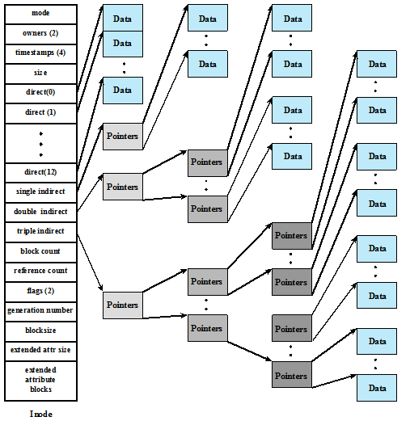
5.7 UNIX文件管理
FreeBSD索引节点和文件的结构
模式
数据
数据
数据
所有者(2)
数据
时间戳(4)
数据
数据
数据
大小
直接块(0)
数据
直接块(1)
数据
数据
指针
指针
数据
数据
直接块(11)
指针
一级间接块
指针
数据
二级间接块
三级间接块
指针
块计数
数据
引用计数
指针
指针
标志(2)
指针
数据
生成编号
指针
指针
块大小
数据
扩展属性大小
扩展
属性块
指针
数据
Notes:
Of course, these items interact and must be considered together. The result is
that there are two major alternatives:
• Variable, large contiguous portions: This will provide better performance. The
variable size avoids waste, and the file allocation tables are small. However,
space is hard to reuse.
• Blocks : Small fixed portions provide greater flexibility. They may require
large tables or complex structures for their allocation. Contiguity has been
abandoned as a primary goal; blocks are allocated as needed.
Either option is compatible with preallocation or dynamic allocation. In
the case of variable, large contiguous portions, a file is preallocated one contiguous
group of blocks. This eliminates the need for a file allocation table; all that is
required is a pointer to the first block and the number of blocks allocated. In the
case of blocks, all of the portions required are allocated at one time. This means that
the file allocation table for the file will remain of fixed size, because the number of
blocks allocated is fixed.
With variable-size portions, we need to be concerned with the fragmentation
of free space. This issue was faced when we considered partitioned main memory in
Chapter 7 . The following are possible alternative strategies:
• First fit: Choose the first unused contiguous group of blocks of sufficient size
from a free block list.
• Best fit: Choose the smallest unused group that is of sufficient size.
• Nearest fit: Choose the unused group of sufficient size that is closest to the
previous allocation for the file to increase locality.
It is not clear which strategy is best. The difficulty in modeling alternative
strategies is that so many factors interact, including types of files, pattern of file
access, degree of multiprogramming, other performance factors in the system, disk
caching, disk scheduling, and so on.

Slide 70
5.7 UNIX文件管理
文件分配是以块为基础完成的
按需动态分配，而非预定义分配
系统为了知道每个文件，采用一种索引方法，索引的一部分保存在该文件的索引节点中
在所有的UNIX实现中，索引节点都包含一些直接指针和三个间接指针（一级、二级、三级）
Notes:
File allocation is done on a block basis. Allocation is dynamic, as needed, rather
than using preallocation. Hence, the blocks of a file on disk are not necessarily contiguous.
An indexed method is used to keep track of each file, with part of the index
stored in the inode for the file. In all UNIX implementations, the inode includes a
number of direct pointers and three indirect pointers (single, double, triple).
The FreeBSD inode includes 120 bytes of address information that is organized
as fifteen 64-bit addresses, or pointers. The first 12 addresses point to the first
12 data blocks of the file. If the file requires more than 12 data blocks, one or more
levels of indirection is used as follows:
• The thirteenth address in the inode points to a block on disk that contains the
next portion of the index. This is referred to as the single indirect block. This
block contains the pointers to succeeding blocks in the file.
• If the file contains more blocks, the fourteenth address in the inode points to
a double indirect block. This block contains a list of addresses of additional
single indirect blocks. Each of single indirect blocks, in turn, contains pointers
to file blocks.
• If the file contains still more blocks, the fifteenth address in the inode points
to a triple indirect block that is a third level of indexing. This block points to
additional double indirect blocks.
All of this is illustrated in Figure 12.15 .

Slide 71
5.7 UNIX文件管理
块大小为4KB时的FreeBSD文件容量
每个地址项长度为8字节
文件最大可以超过500G
级
块 数
字 节 数
直接
一级间接
二级间接
三级间接
Notes:
The total number of data blocks
in a file depends on the capacity of the fixed-size blocks in the system. In
FreeBSD, the minimum block size is 4 Kbyte, and each block can hold a total of
512 block addresses. Thus, the maximum size of a file with this block size is over
500 GB ( Table 12.3 ).
This scheme has several advantages:
1. The inode is of fixed size and relatively small and hence may be kept in main
memory for long periods.
2. Smaller files may be accessed with little or no indirection, reducing processing
and disk access time.
3. The theoretical maximum size of a file is large enough to satisfy virtually all
applications.

Slide 72
5.7 UNIX文件管理
索引节点练习
设文件索引节点中有7个地址项，其中4个地址项为直接地址索引，2个地址项是一级间接地址索引，1个地址项是二级间接地址索引，每个地址项大小为4字节，若磁盘索引块和磁盘数据块大小均为256字节，则可表示的单个文件的最大长度是？
每个索引块中的项目数为：256/4=64个
4个地址项为直接地址索引，对应的文件大小为：4×256/1024=1KB
2个地址项是一级间接地址索引，对应的文件大小为：2×64×256/1024=32KB
1个地址项是二级间接地址索引，对应的文件大小为：1×64×64×256/1024=1024KB
单个文件的最大长度为：1+32+1024=1057KB

Slide 73
假定磁盘块的大小为1KB，每个盘块号占4个字节，文件索引节点中的磁盘地址明细表如图所示，如何将下列文件的字节偏移量转换为物理地址？
1． 9000 2． 14000 3． 350000
0
1
2
3
4
5
6
7
8
9
10
11
12
0
1011
109
954
952
……
4096
228
4542
0
3
11111
50
101
367
0
428
9156
824
索引节点练习题
1
2
3
…
3300
333
308
……
74
428
75
0
331
452
…..
76
1
331
9156

Slide 74
5.7 UNIX文件管理
索引节点练习题解答
1. 字节偏移量为9000
逻辑块号为：9000/1024＝8
块内偏移量为：9000－8×1024＝808
因逻辑块号小于10，因此该块为直接块。其物理盘块号为367，该块中的第808字节即为文件的第9000字节。
Notes:
Directories are structured in a hierarchical tree. Each directory can contain files
and/or other directories. A directory that is inside another directory is referred to
as a subdirectory. As was mentioned, a directory is simply a file that contains a
list of file names plus pointers to associated inodes. Figure 12.16 shows the overall
structure. Each directory entry (dentry) contains a name for the associated file or
subdirectory plus an integer called the i-number (index number). When the file or
directory is accessed, its i-number is used as an index into the inode table.

Slide 75
5.7 UNIX文件管理
索引节点练习题解答（续）
2. 字节偏移量为14000
逻辑块号为：14000/1024＝13
块内偏移量为：14000－13×1024＝688
因逻辑块号10<13<266，因此该块为一次间接块。
由图可知，一次间接的盘块号为428，从一次间接块中读出盘块号表，查得其物理块号为952，该块中的第688字节即为文件的第14000字节。
Notes:
Directories are structured in a hierarchical tree. Each directory can contain files
and/or other directories. A directory that is inside another directory is referred to
as a subdirectory. As was mentioned, a directory is simply a file that contains a
list of file names plus pointers to associated inodes. Figure 12.16 shows the overall
structure. Each directory entry (dentry) contains a name for the associated file or
subdirectory plus an integer called the i-number (index number). When the file or
directory is accessed, its i-number is used as an index into the inode table.

Slide 76
5.7 UNIX文件管理
索引节点练习题解答（续）
3. 字节偏移量为350000
逻辑块号为：350000/1024＝341
块内偏移量为：350000－341×1024＝816
因逻辑块号266<341<65802，因此该块为二次间接块。
由图可知，二次间接块的盘块号为9156。由于一个一次间接块中可容纳256个块号，341-10-256＝75
因此，字节偏移量350000在二次间接块的第0个一次间接块的第75个表项中，其盘块号为333，该块中的第816字节即为文件的第350000字节。
Notes:
Directories are structured in a hierarchical tree. Each directory can contain files
and/or other directories. A directory that is inside another directory is referred to
as a subdirectory. As was mentioned, a directory is simply a file that contains a
list of file names plus pointers to associated inodes. Figure 12.16 shows the overall
structure. Each directory entry (dentry) contains a name for the associated file or
subdirectory plus an integer called the i-number (index number). When the file or
directory is accessed, its i-number is used as an index into the inode table.

Slide 77
5.7 UNIX文件管理
UNIX目录和索引节点
索引节点表
目录
Notes:
Directories are structured in a hierarchical tree. Each directory can contain files
and/or other directories. A directory that is inside another directory is referred to
as a subdirectory. As was mentioned, a directory is simply a file that contains a
list of file names plus pointers to associated inodes. Figure 12.16 shows the overall
structure. Each directory entry (dentry) contains a name for the associated file or
subdirectory plus an integer called the i-number (index number). When the file or
directory is accessed, its i-number is used as an index into the inode table.

Slide 78
5.7 UNIX文件管理
UNIX文件系统驻留在单个逻辑磁盘或磁盘分区
引导块
（Boot block）
包含引导操作系统的代码
超级块
（Superblock）
包含有关文件系统的属性和信息，如分区大小、索引节点表的大小
索引节点表
（Inode table）
所有文件的索引节点集
数据块
（Data blocks）
数据文件和子目录文件所需的存储空间
Notes:
A UNIX file system resides on a single logical disk or disk partition and is laid out
with the following elements:
• Boot block: Contains code required to boot the operating system
• Superblock: Contains attributes and information about the file system, such as
partition size, and inode table size
• Inode table: The collection of inodes for each file
• Data blocks: Storage space available for data files and subdirectories

Slide 79
5.7 UNIX文件管理
文件系统布局
整个磁盘
分区表
磁盘分区
MBR
引导块
超级块
i节点表
数据块
Notes:
A UNIX file system resides on a single logical disk or disk partition and is laid out
with the following elements:
• Boot block: Contains code required to boot the operating system
• Superblock: Contains attributes and information about the file system, such as
partition size, and inode table size
• Inode table: The collection of inodes for each file
• Data blocks: Storage space available for data files and subdirectories

Slide 80
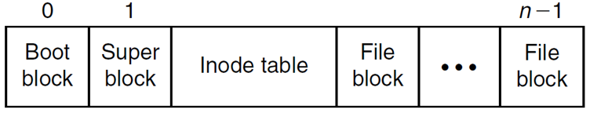
5.7 UNIX文件管理
UNIX中的路径解析——/programs/pong.c
在inode table里存放了每个文件的inode，所以查找inode是关键
Notes:
A UNIX file system resides on a single logical disk or disk partition and is laid out
with the following elements:
• Boot block: Contains code required to boot the operating system
• Superblock: Contains attributes and information about the file system, such as
partition size, and inode table size
• Inode table: The collection of inodes for each file
• Data blocks: Storage space available for data files and subdirectories

Slide 81
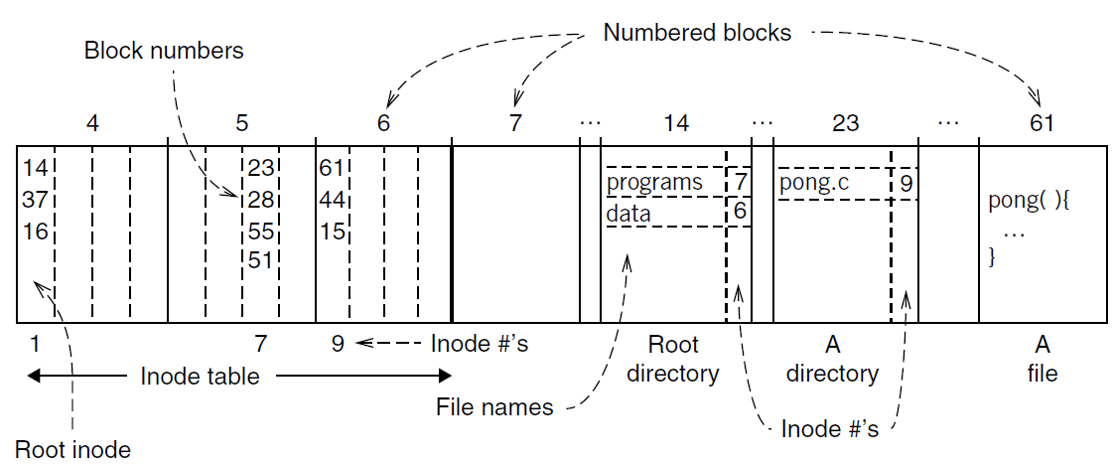
5.7 UNIX文件管理
UNIX中的路径解析——/programs/pong.c
找到索引节点表里第1个表项，记录了根目录文件的存储位置，第一个块为14块
找到14块，看到programs文件的inode号为7
在索引节点表里找第7个表项，记录了programs目录文件的存放位置，第一个块为23块
找到23块，看到pong.c文件的inode号为9
在索引节点表里找第9个表项，记录了pong.c文件的存放位置，第一个块为61块
依次访问61，44，15块，可得到Pong.c文件的内容
Notes:
A UNIX file system resides on a single logical disk or disk partition and is laid out
with the following elements:
• Boot block: Contains code required to boot the operating system
• Superblock: Contains attributes and information about the file system, such as
partition size, and inode table size
• Inode table: The collection of inodes for each file
• Data blocks: Storage space available for data files and subdirectories

Slide 82
5.8 Windows文件系统
Windows NT的开发人员设计的新文件系统——NTFS，旨在满足工作站和服务器的高端要求
NTFS的主要特性:
可恢复性
安全性
大磁盘和大文件
多数据流
日志
压缩和加密
硬链接和符号链接
Notes:
The developers of Windows NT designed a new file system, the New Technology
File System (NTFS), which is intended to meet high-end requirements for workstations
and servers. Examples of high-end applications include the following:
• Client/server applications such as file servers, compute servers, and database
servers
• Resource-intensive engineering and scientific applications
• Network applications for large corporate systems
NTFS is a flexible and powerful file system built, as we shall see, on an elegantly simple
file system model. The most noteworthy features of NTFS include the following:
• Recoverability: High on the list of requirements for the new Windows file
system was the ability to recover from system crashes and disk failures. In the
event of such failures, NTFS is able to reconstruct disk volumes and return
them to a consistent state. It does this by using a transaction-processing model
for changes to the file system; each significant change is treated as an atomic
action that is either entirely performed or not performed at all. Each transaction
that was in process at the time of a failure is subsequently backed out or
brought to completion. In addition, NTFS uses redundant storage for critical
file system data, so that failure of a disk sector does not cause the loss of data
describing the structure and status of the file system.
• Security: NTFS uses the Windows object model to enforce security. An open
file is implemented as a file object with a security descriptor that defines its
security attributes. The security descriptor is persisted as an attribute of each
file on disk.
• Large disks and large files: NTFS supports very large disks and very large files
more efficiently than other file systems, such as FAT.
• Multiple data streams: The actual contents of a file are treated as a stream of
bytes. In NTFS, it is possible to define multiple data streams for a single file.
An example of the utility of this feature is that it allows Windows to be used
by remote Macintosh systems to store and retrieve files. On Macintosh, each
file has two components: the file data and a resource fork that contains information
about the file. NTFS treats these two components as two data streams
within a single file.
• Journaling: NTFS keeps a log of all changes made to files on the volumes.
Programs, such as desktop search, can read the journal to identify what files
have changed.
• Compression and encryption: Entire directories and individual files can be
transparently compressed and/or encrypted.
• Hard and symbolic l inks: In order to support POSIX, Windows has always supported
“hard links,” which allow a single file to be accessible by multiple path
names on the same volume. Starting with Windows Vista, “symbolic links”
are supported which allow a file or directory to be accessible by multiple path
names, even if the names are on different volumes. Windows also supports
“mount points” which allow volumes to appear at junction points on other
volumes, rather than be named by driver letters, such as “D:”.

Slide 83
5.8 Windows文件系统
NTFS使用下列磁盘存储概念:
扇区
（Sector）
硬盘中最小的物理存储单元
一个扇区中存储的数据量是2的幂，通常为512字节
簇
（Cluster）
一个或多个连续的扇区
一个簇中的扇区数量也是2的幂
卷
（Volume）
磁盘上的逻辑分区，由一个或多个簇组成，供文件系统分配空间时使用
卷可以是整个磁盘，也可以是一部分磁盘，还可以跨越多个磁盘
NTFS中，单个卷的最大值为2⁶⁴字节
使用簇为分配的单位，支持大文件
Notes:
Of course, these items interact and must be considered together. The result is
that there are two major alternatives:
• Variable, large contiguous portions: This will provide better performance. The
variable size avoids waste, and the file allocation tables are small. However,
space is hard to reuse.
• Blocks : Small fixed portions provide greater flexibility. They may require
large tables or complex structures for their allocation. Contiguity has been
abandoned as a primary goal; blocks are allocated as needed.
Either option is compatible with preallocation or dynamic allocation. In
the case of variable, large contiguous portions, a file is preallocated one contiguous
group of blocks. This eliminates the need for a file allocation table; all that is
required is a pointer to the first block and the number of blocks allocated. In the
case of blocks, all of the portions required are allocated at one time. This means that
the file allocation table for the file will remain of fixed size, because the number of
blocks allocated is fixed.
With variable-size portions, we need to be concerned with the fragmentation
of free space. This issue was faced when we considered partitioned main memory in
Chapter 7 . The following are possible alternative strategies:
• First fit: Choose the first unused contiguous group of blocks of sufficient size
from a free block list.
• Best fit: Choose the smallest unused group that is of sufficient size.
• Nearest fit: Choose the unused group of sufficient size that is closest to the
previous allocation for the file to increase locality.
It is not clear which strategy is best. The difficulty in modeling alternative
strategies is that so many factors interact, including types of files, pattern of file
access, degree of multiprogramming, other performance factors in the system, disk
caching, disk scheduling, and so on.

Slide 84
5.8 Windows文件系统
Windows NTFS分区大小和簇大小
卷 大 小
每簇的扇区数
簇 大 小
Notes:
Table 12.4 shows the default cluster sizes for NTFS. The defaults depend on
the size of the volume. The cluster size that is used for a particular volume is established
by NTFS when the user requests that a volume be formatted.

Slide 85
5.8 Windows文件系统
Windows NTFS卷布局
分区引导扇区
主文件表MFT
文件区域
系统文件
分区引导扇区：卷开始的一些扇区，包含卷的布局信息、文件系统的结构、引导启动信息和代码
主文件表：包含该NTFS卷中所有的文件和文件夹（目录）信息
系统文件：包含MFT前几行的镜像、log文件、簇的位图、属性定义表
Notes:
NTFS uses a remarkably simple but powerful approach
to organizing information on a disk volume. Every element on a volume is a file,
and every file consists of a collection of attributes. Even the data contents of a file is
treated as an attribute. With this simple structure, a few general-purpose functions
suffice to organize and manage a file system.
Figure 12.19 shows the layout of an NTFS volume, which consists of four
regions. The first few sectors on any volume are occupied by the partition boot
sector (although it is called a sector, it can be up to 16 sectors long), which contains
information about the volume layout and the file system structures as well as boot
startup information and code. This is followed by the master file table (MFT) , which
contains information about all of the files and folders (directories) on this NTFS
volume. In essence, the MFT is a list of all files and their attributes on this NTFS
volume, organized as a set of rows in a table structure.
Following the MFT is a region containing system files . Among the files in this
region are the following:
• MFT2: A mirror of the first few rows of the MFT, used to guarantee access to
the volume in the case of a single-sector failure in the sectors storing the MFT.
• Log file: A list of transaction steps used for NTFS recoverability.
• Cluster bit map: A representation of the space on the volume, showing which
clusters are in use.
• Attribute definition table: Defines the attribute types supported on this
volume and indicates whether they can be indexed and whether they can be
recovered during a system recovery operation.

Slide 86
5.8 Windows文件系统
Windows文件系统的核心是MFT（主文件表，Master File Table ）
MFT由记录构成，每条记录1024字节
每条记录描述该卷上的文件，包括MFT本身，MFT也被视为文件
每条记录由一组属性组成，这些属性用于定义文件（或文件夹）特征和文件内容
Notes:
The heart of the Windows file system is the MFT. The MFT
is organized as a table of 1,024-byte rows, called records. Each row describes a file
on this volume, including the MFT itself, which is treated as a file. If the contents of
a file are small enough, then the entire file is located in a row of the MFT. Otherwise,
the row for that file contains partial information and the remainder of the file spills
over into other available clusters on the volume, with pointers to those clusters in
the MFT row of that file.
Each record in the MFT consists of a set of attributes that serve to define the
file (or folder) characteristics and the file contents.

Slide 87
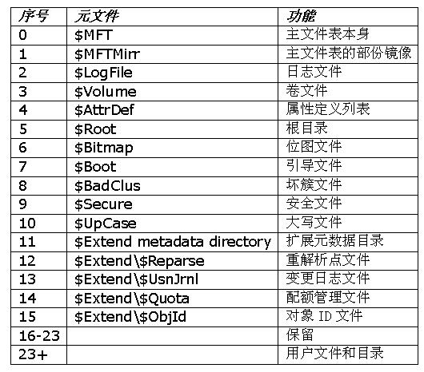
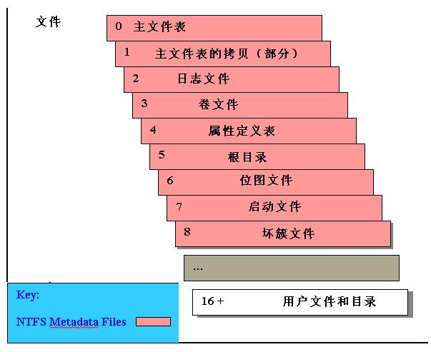
5.8 Windows文件系统
MFT的前16个元数据文件非常重要，为了防止数据的丢失，NTFS系统在该卷中对其做了备份。

Slide 88
5.8 Windows文件系统
MFT中每条记录包含的属性类型
属性类型 | 说明
标准信息 | 包括访问属性（只读、读/写等）、时间戳、文件创建的时间和最后一次被修改时间、有多少目录指向该文件
属性表 | 组成文件的属性列表，当一个记录无法存下一个文件的所有属性时，需要多个记录，属性表包含了对MFT中包含每个属性的记录的引用
文件名 安全描述符 数据 | 一个文件或目录必须有一个或多个名字 确定谁拥有这个文件，谁可以访问它 文件的内容
索引根 索引分配 卷信息 位图 | 用于实现文件夹 用于实现文件夹 包括与卷相关的信息，如版本信息、卷名字 提供在MFT或文件夹中正在使用的记录的图（map）

Slide 89
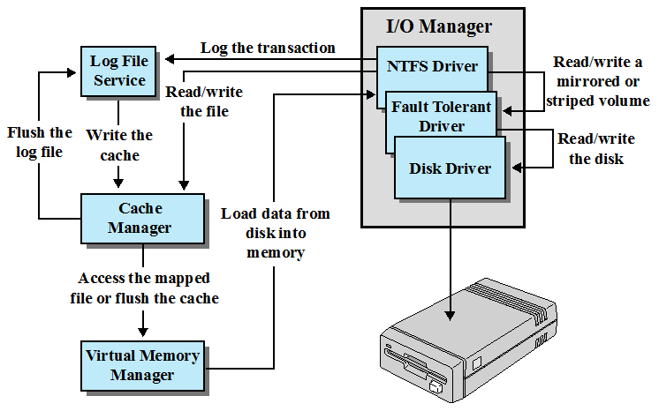
5.8 Windows文件系统
Windows NTFS组件
I/O管理器
日志文件
服务
记录事务
NTFS驱动
读写一个镜像的或条带化的卷
读/写
文件
容错驱动
刷新
日志文件
写
高速缓存
读写磁盘
磁盘驱动
高速缓存
管理器
从磁盘加载
数据到内存
访问映射文件或刷新高速缓存
虚拟内存
管理器
I/O管理程序：包括NTFS驱动，用于处理基本的打开、关闭、读写功能
日志文件服务：维护一个关于磁盘上文件系统元数据改变的标志，用于在系统失败时恢复NTFS格式的卷
高速缓存管理器：负责对文件读写进行高速缓存，以提高性能
虚存管理程序：NTFS通过把文件引用映射到虚存引用，并通过读写虚存来访问被缓存的文件
Notes:
NTFS makes it possible to recover the file system to a consistent state following a
system crash or disk failure. The key elements that support recoverability are as
follows ( Figure 12.20 ):
• I/O manager: Includes the NTFS driver, which handles the basic open, close,
read, and write functions of NTFS. In addition, the software RAID module
FTDISK can be configured for use.
• Log file service: Maintains a log of file system metadata changes on disk. The
log file is used to recover an NTFS-formatted volume in the case of a system
failure (i.e., without having to run the file system check utility).
• Cache manager: Responsible for caching file reads and writes to enhance
performance. The cache manager optimizes disk I/O.
• Virtual memory manager: The NTFS accesses cached files by mapping file references
to virtual memory references and reading and writing virtual memory.
It is important to note that the recovery procedures used by NTFS are designed
to recover file system metadata, not file contents. Thus, the user should never lose a
volume or the directory/file structure of an application because of a crash. However,
user data are not guaranteed by the file system. Providing full recoverability, including
user data, would make for a much more elaborate and resource-consuming
recovery facility.
The essence of the NTFS recovery capability is logging. Each operation that
alters a file system is treated as a transaction. Each suboperation of a transaction
that alters important file system data structures is recorded in a log file before being
recorded on the disk volume. Using the log, a partially completed transaction at the
time of a crash can later be redone or undone when the system recovers.
In general terms, these are the steps taken to ensure recoverability, as
described in [RUSS11]:
1. NTFS first calls the log file system to record in the log file (in the cache) any
transactions that will modify the volume structure.
2. NTFS modifies the volume (in the cache).
3. The cache manager calls the log file system to prompt it to flush the log file to
disk.
4. Once the log file updates are safely on disk, the cache manager flushes the
volume changes to disk.

Slide 90
5.8 Windows文件系统
NTFS保证可恢复性的几个基本步骤
NTFS首先调用日志文件服务，在缓存中的日志文件中记录任何将会修改卷结构的事务；
NTFS修改这个卷（在高速缓存中）
高速缓存管理器调用日志文件服务，提示它刷新磁盘中的日志文件
在磁盘上更新日志文件安全时，高速缓存管理器把该卷的变化刷新到磁盘中

Slide 91
5.9 Linux虚拟文件系统
应用程序
用户
空间
GNU C库
系统调用接口
Inode 缓存
虚拟文件系统 VFS
目录缓存
文件
系统
单个文件系统
内核
空间
设备驱动
Notes:
Linux includes a versatile and powerful file-handling facility, designed to support a
wide variety of file management systems and file structures. The approach taken in
Linux is to make use of a virtual file system (VFS) , which presents a single, uniform
file system interface to user processes. The VFS defines a common file model that is
capable of representing any conceivable file system’s general feature and behavior.
The VFS assumes that files are objects in a computer’s mass storage memory that
share basic properties regardless of the target file system or the underlying processor
hardware. Files have symbolic names that allow them to be uniquely identified
within a specific directory within the file system. A file has an owner, protection
against unauthorized access or modification, and a variety of other properties. A
file may be created, read from, written to, or deleted. For any specific file system, a
mapping module is needed to transform the characteristics of the real file system to
the characteristics expected by the virtual file system.
Figure 12.17 indicates the key ingredients of the Linux file system strategy. A
user process issues a file system call (e.g., read) using the VFS file scheme. The VFS
converts this into an internal (to the kernel) file system call that is passed to a mapping
function for a specific file system [e.g., IBM’s Journaling File System (JFS)]. In
most cases, the mapping function is simply a mapping of file system functional calls
from one scheme to another. In some cases, the mapping function is more complex.
For example, some file systems use a file allocation table (FAT), which stores the
position of each file in the directory tree. In these file systems, directories are not
files. For such file systems, the mapping function must be able to construct dynamically,
and when needed, the files corresponding to the directories. In any case, the
original user file system call is translated into a call that is native to the target file
system. The target file system software is then invoked to perform the requested
function on a file or directory under its control and secondary storage. The results
of the operation are then communicated back to the user in a similar fashion.

Slide 92
5.9 Linux虚拟文件系统
使用VFS用户接口的系统调用
VFS系统调用
使用X文件系统用户接口的系统调用
磁盘
I/O调用
Linux虚拟文件系统
到X文件系统的映射函数
X文件系统
用户
进程
由X文件系统维护的辅存中的文件
Notes:
Figure 12.18 indicates the role that VFS plays within the Linux kernel. When
a process initiates a file-oriented system call (e.g., read), the kernel calls a function
in the VFS. This function handles the file-system-independent manipulations and
initiates a call to a function in the target file system code. This call passes through
a mapping function that converts the call from the VFS into a call to the target file
system. The VFS is independent of any file system, so the implementation of a mapping
function must be part of the implementation of a file system on Linux. The
target file system converts the file system request into device-oriented instructions
that are passed to a device driver by means of page cache functions.
VFS is an object-oriented scheme. Because it is written in C, rather than a
language that supports object programming (such as C++ or Java), VFS objects are
implemented simply as C data structures. Each object contains both data and pointers
to file-system-implemented functions that operate on data.

Slide 93

VFS主要的四个对象
5.9 Linux虚拟文件系统
超级块对象
代表一个挂载的文件系统
目录对象
代表一个具体的目录
索引节点对象
代表一个具体的文件
文件对象
代表一个与进程相关的打开的文件
Notes:
The four primary
object types in VFS are as follows:
• Superblock object: Represents a specific mounted file system
• Inode object: Represents a specific file
• Dentry object: Represents a specific directory entry
• File object: Represents an open file associated with a process
This scheme is based on the concepts used in UNIX file systems, as described in
Section 12.7 . The key concepts of UNIX file system to remember are the following. A
file system consists of a hierarchal organization of directories. A directory is the same
as what is known as a folder on many non-UNIX platforms and may contain files and/
or other directories. Because a directory may contain other directories, a tree structure
is formed. A path through the tree structure from the root consists of a sequence
of directory entries, ending in either a directory entry (dentry) or a file name. In
UNIX, a directory is implemented as a file that lists the files and directories contained
within it. Thus, file operations can be performed on either files or directories.

Slide 94
作业
作业9
1. 选择文件组织时的重要原则是什么，列举并简单定义5种文件组织。
2. 列举并简单定义3种文件文件分配方法。
3. 试说明UNIX系统中所采用的混合索引分配方式。
4. 什么是目录，操作系统为什么要引入目录？列举并简单定义对目录执行的典型操作。
5. UNIX系统是如何实现文件共享（一份文件实体、多个别名）的？
6. 请叙述课件“UNIX中的路径解析——/programs/pong.c”中的路径解析过程。
Notes:
Of course, these items interact and must be considered together. The result is
that there are two major alternatives:
• Variable, large contiguous portions: This will provide better performance. The
variable size avoids waste, and the file allocation tables are small. However,
space is hard to reuse.
• Blocks : Small fixed portions provide greater flexibility. They may require
large tables or complex structures for their allocation. Contiguity has been
abandoned as a primary goal; blocks are allocated as needed.
Either option is compatible with preallocation or dynamic allocation. In
the case of variable, large contiguous portions, a file is preallocated one contiguous
group of blocks. This eliminates the need for a file allocation table; all that is
required is a pointer to the first block and the number of blocks allocated. In the
case of blocks, all of the portions required are allocated at one time. This means that
the file allocation table for the file will remain of fixed size, because the number of
blocks allocated is fixed.
With variable-size portions, we need to be concerned with the fragmentation
of free space. This issue was faced when we considered partitioned main memory in
Chapter 7 . The following are possible alternative strategies:
• First fit: Choose the first unused contiguous group of blocks of sufficient size
from a free block list.
• Best fit: Choose the smallest unused group that is of sufficient size.
• Nearest fit: Choose the unused group of sufficient size that is closest to the
previous allocation for the file to increase locality.
It is not clear which strategy is best. The difficulty in modeling alternative
strategies is that so many factors interact, including types of files, pattern of file
access, degree of multiprogramming, other performance factors in the system, disk
caching, disk scheduling, and so on.

